Slide 1



EDoctor Application
Team-4
Sagnik Bhunia
Oggula Rikitha
Palla Pravallika
Rajibul Islam

Slide 2
Objective
The objective of the EDoctor Application is to develop a web-based platform that simplifies outpatient appointment booking by:
Providing a seamless and user-friendly interface for patients to schedule appointments.
Offering doctors an efficient system to manage their schedules and patient interactions.
Streamlining the appointment management process to enhance overall healthcare service delivery.

Slide 3

Introduction
The EDoctor Application is a web-based platform designed to revolutionize the process of booking outpatient appointments. By connecting patients and doctors through a seamless interface, the application eliminates inefficiencies in traditional scheduling methods. It offers features such as user authentication, real-time appointment booking, doctor availability management, and automated notifications.
This project aims to improve the experience of healthcare delivery by simplifying appointment management for both patients and doctors, ensuring convenience, accessibility, and satisfaction for all stakeholders involved.

Slide 4
Services we provide
User Authentication & Management
Appointment Scheduling
Website Statistics & Reporting
Doctor & Patient Management

Slide 5
Requirements
Software
Hardware
Frontend: React.js, Node.js
Backend: Spring Boot, Maven
Database: MySQL
Tools: IntelliJ IDEA/Eclipse, Visual Studio Code, Postman, MySQL Workbench
OS: Windows 10/11, macOS, or Linux
Processor: Intel i3+ / AMD equivalent
RAM: 8 GB (Recommended: 16 GB)
Storage: 256 GB SSD or 500 GB HDD (Recommended: 512 GB SSD)
Internet: Stable connection

Slide 6
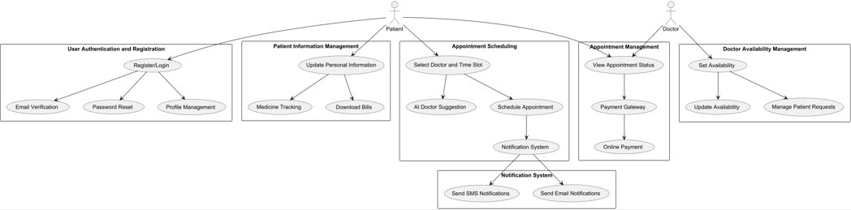
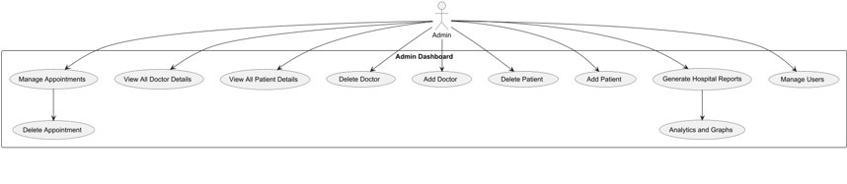
Use-Case Diagram

Slide 7
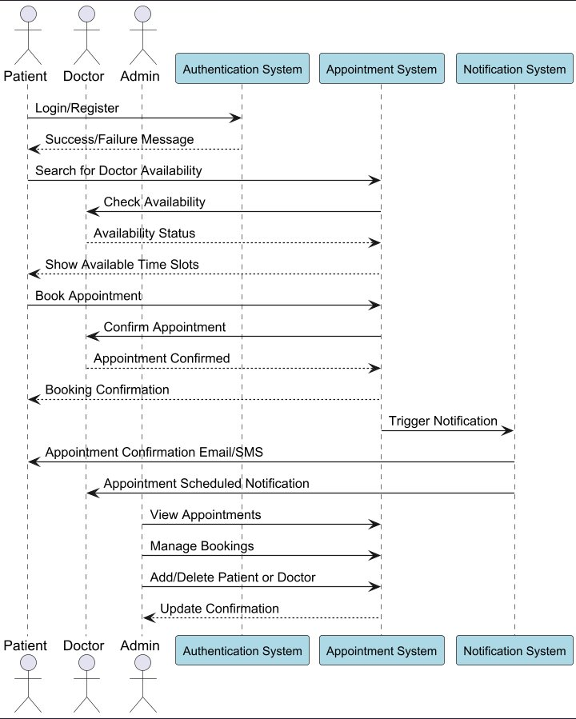
Sequence Diagram

Slide 8
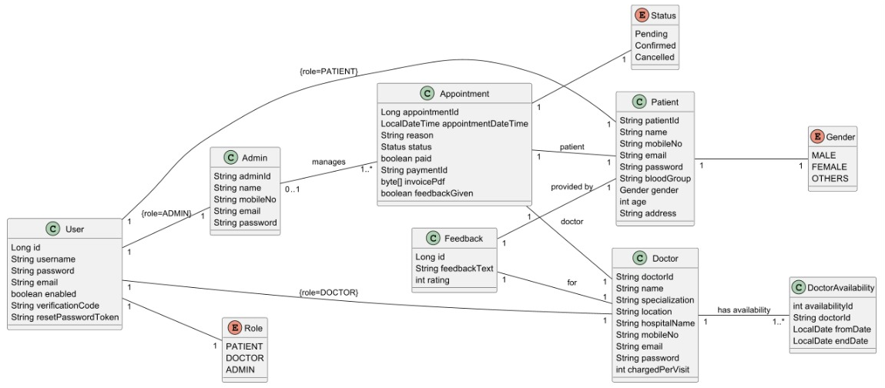
Class Diagram

Slide 9

01
User Authentication
User Registration: Users can register by providing their details, validated and stored securely.
Login: Users authenticate via username and password, with a response based on validity.
Email Verification: Users confirm their email using a verification code (OTP).
Password Reset: Users can request a reset token and update their password.

Slide 10
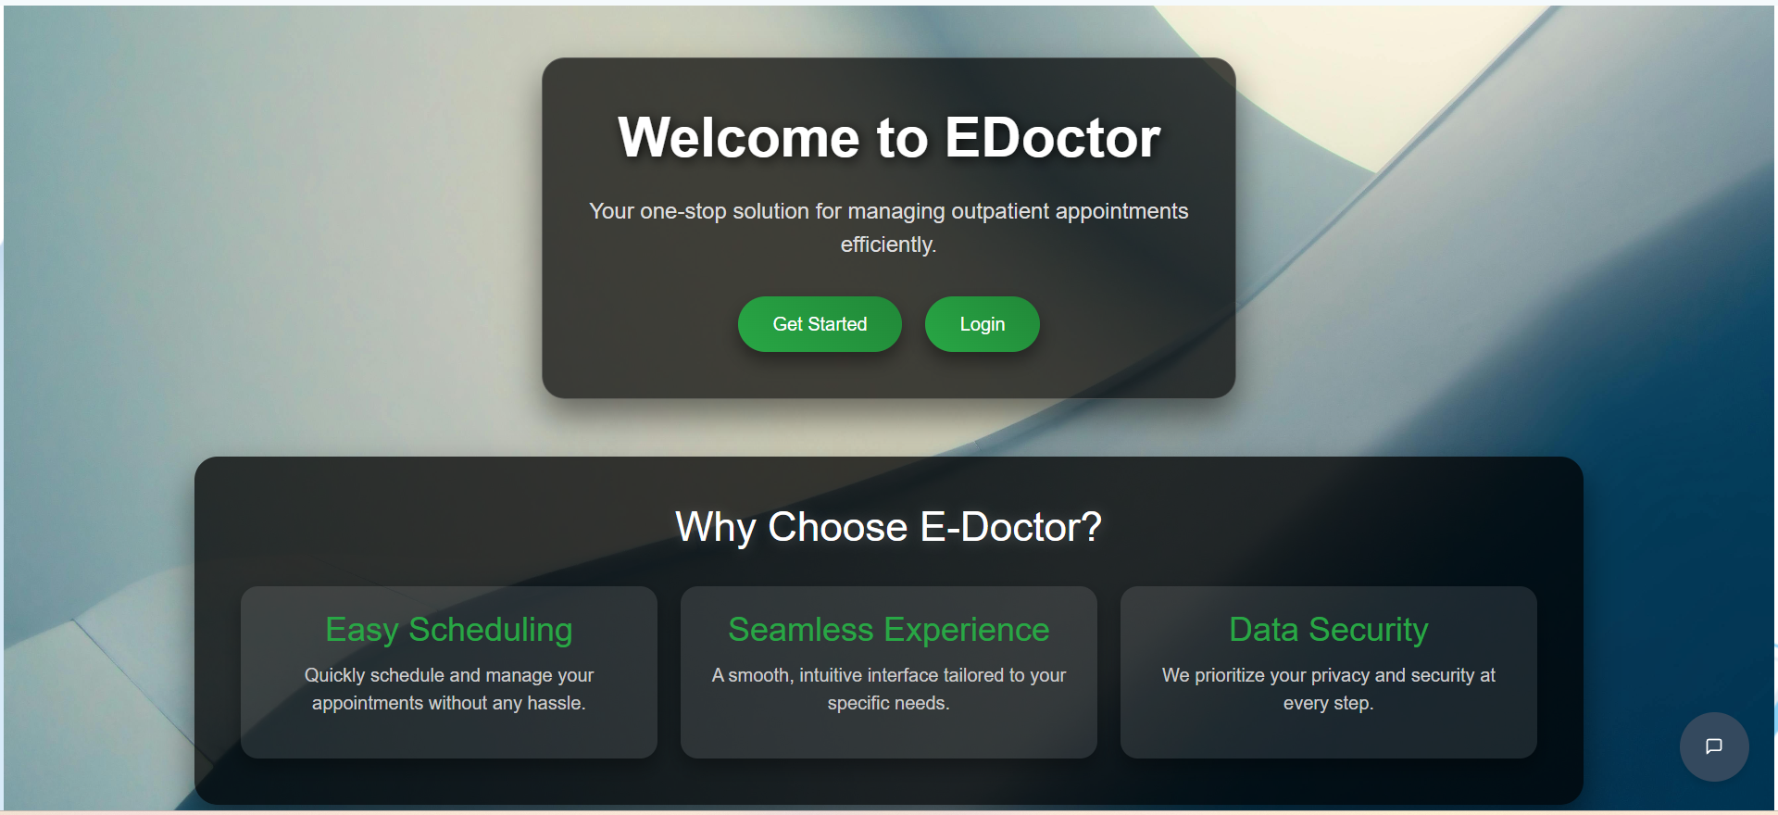
Landing Page

Slide 11
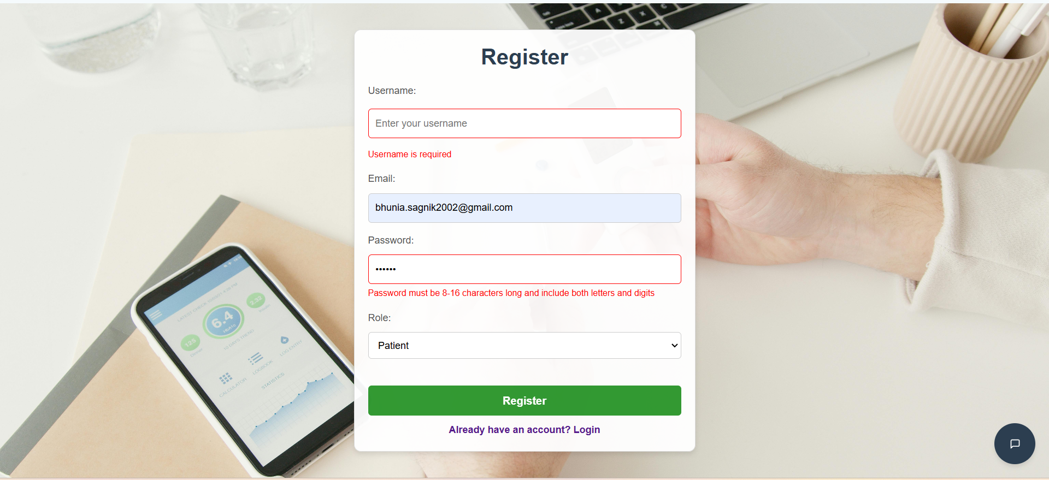
User Registration Page

Slide 12
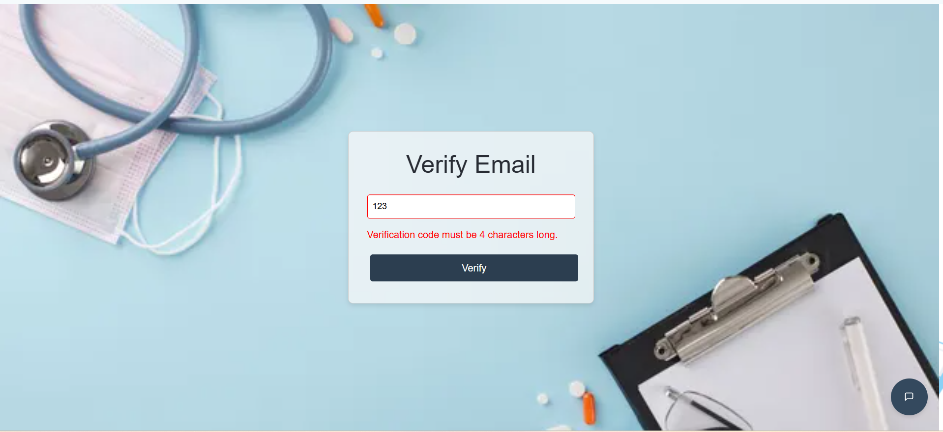
Email Verification Page

Slide 13
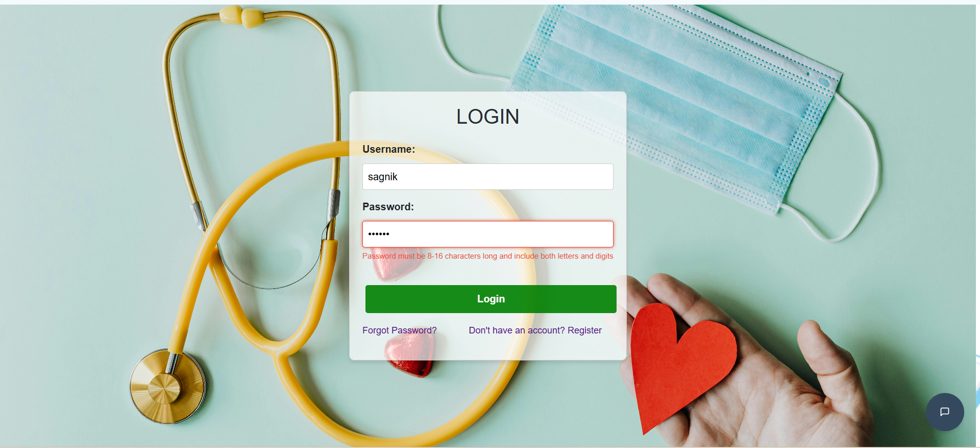
Login Page

Slide 14
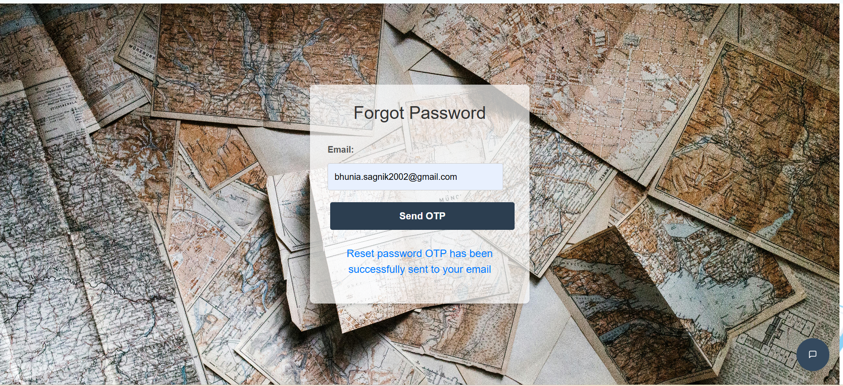
Forgot-Password Page

Slide 15
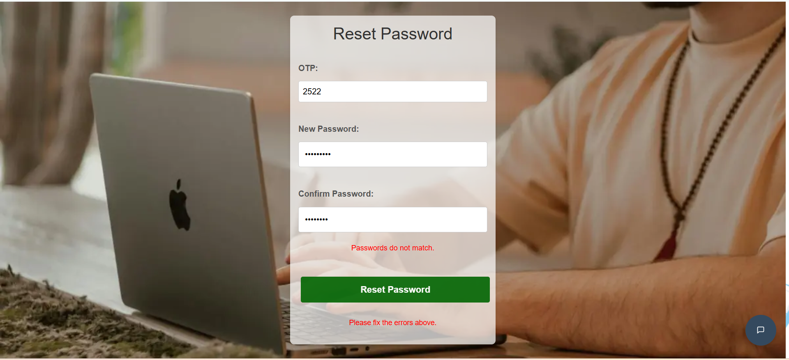
Reset-Password Page

Slide 16
02
Patient
Profile Management:
View and update personal information, medical history, and daily medicine schedules.
Find Doctors:
Search for doctors by specialization, location, and availability. AI suggestions recommend suitable doctors.
Make Appointment:
Schedule appointments with doctors, select time slots, and provide reasons for the consultation. Payments can be made online or in cash.
Appointment Management:
View, manage, and track appointments with status updates and reminders.
Pay Fees:
Make payments securely online or opt for cash. Download hospital bills directly from the dashboard.
Provide Feedback:
Rate doctors and provide feedback after consultations.

Slide 17
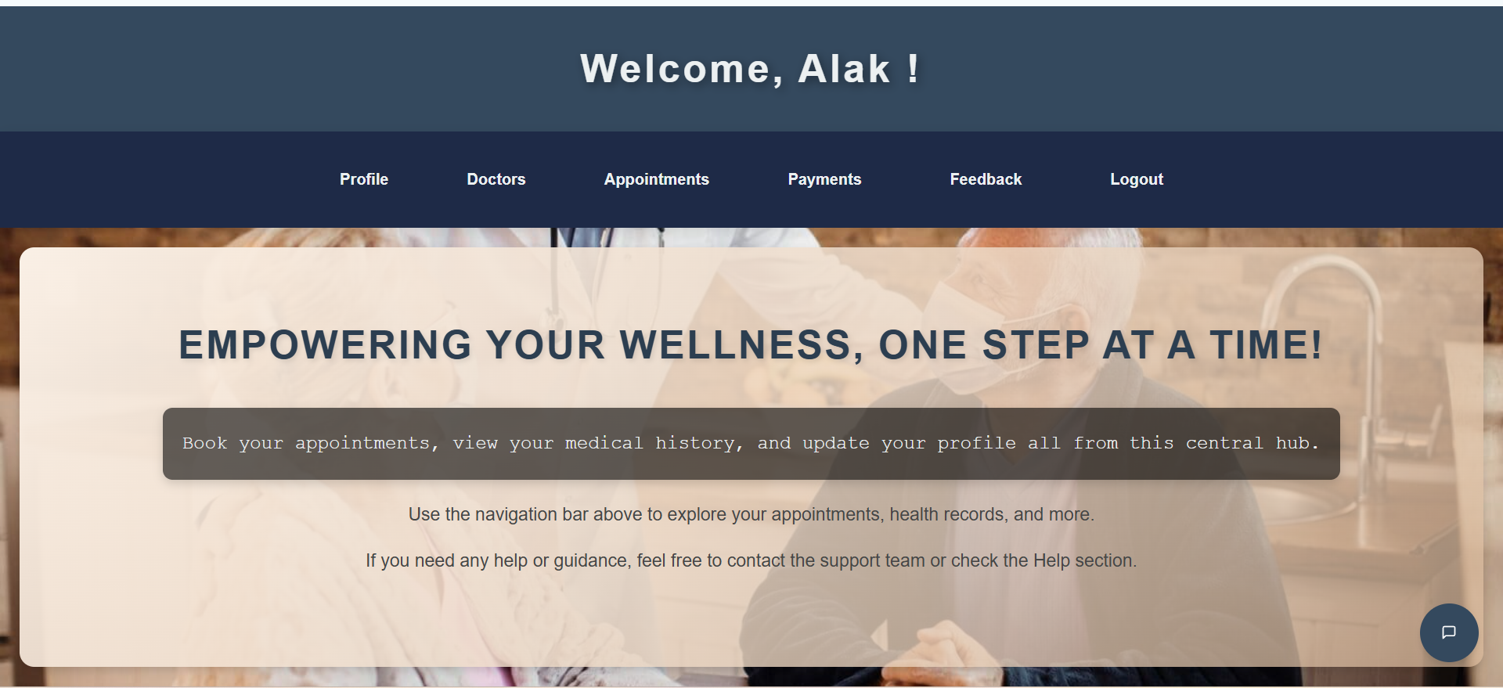
Patient Dashboard

Slide 18
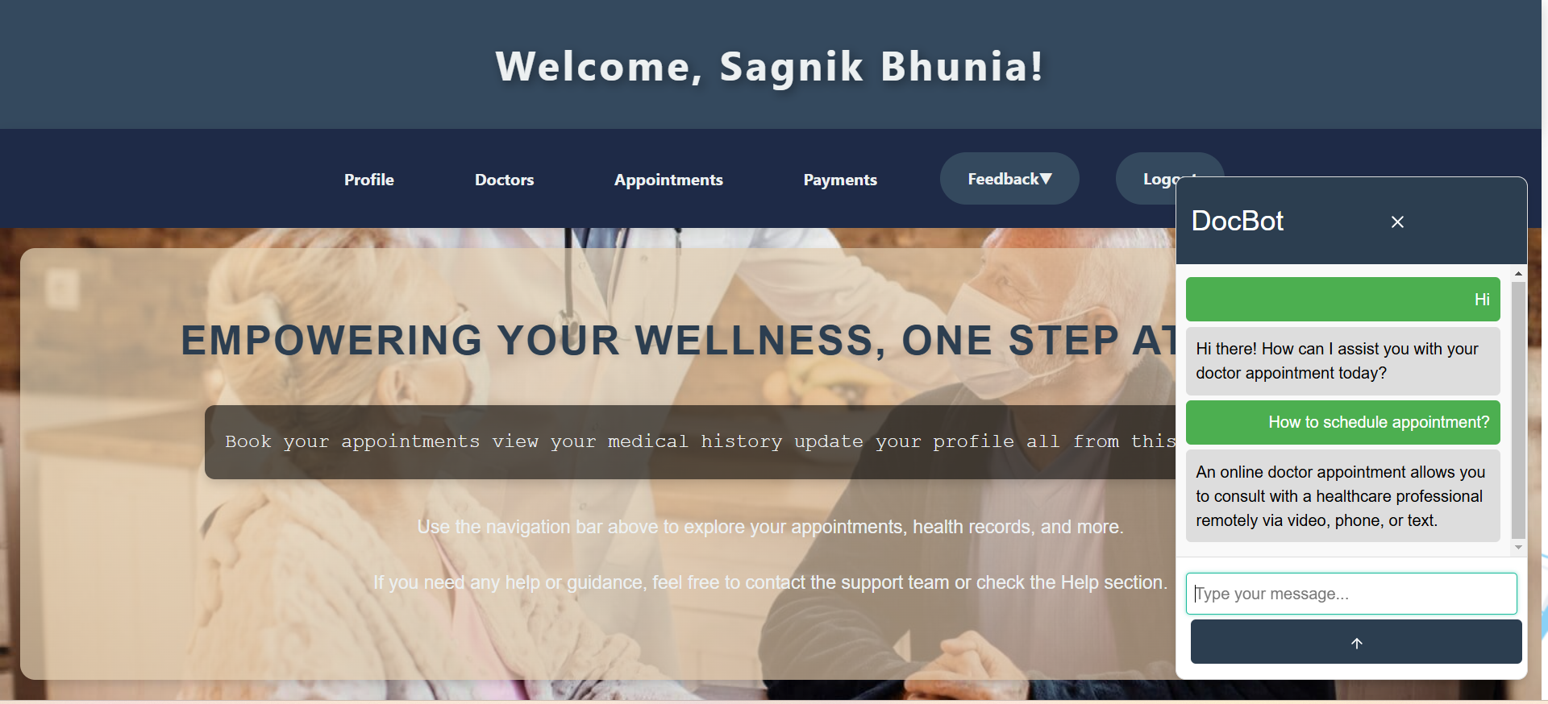
Chat-Bot

Slide 19
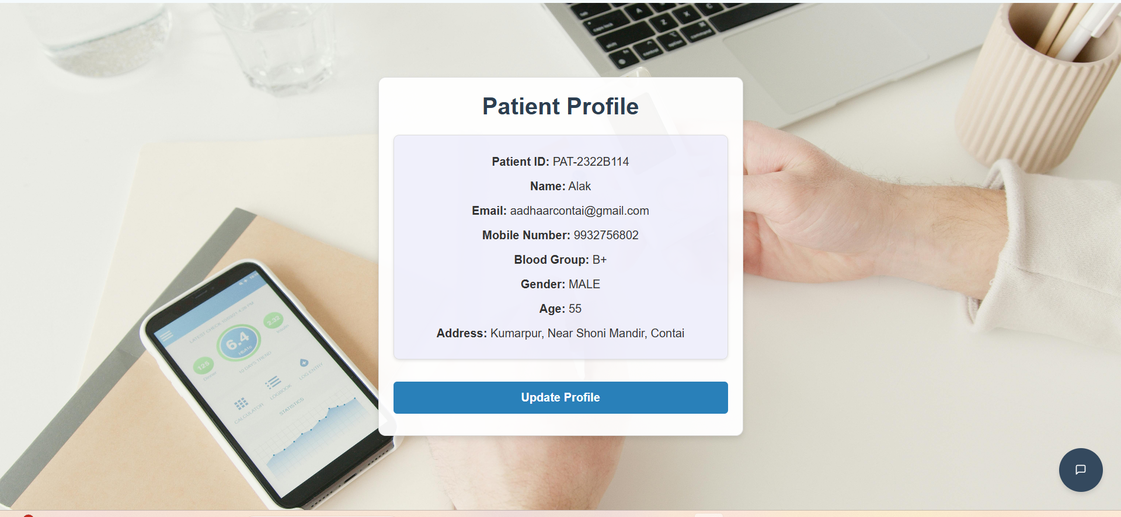
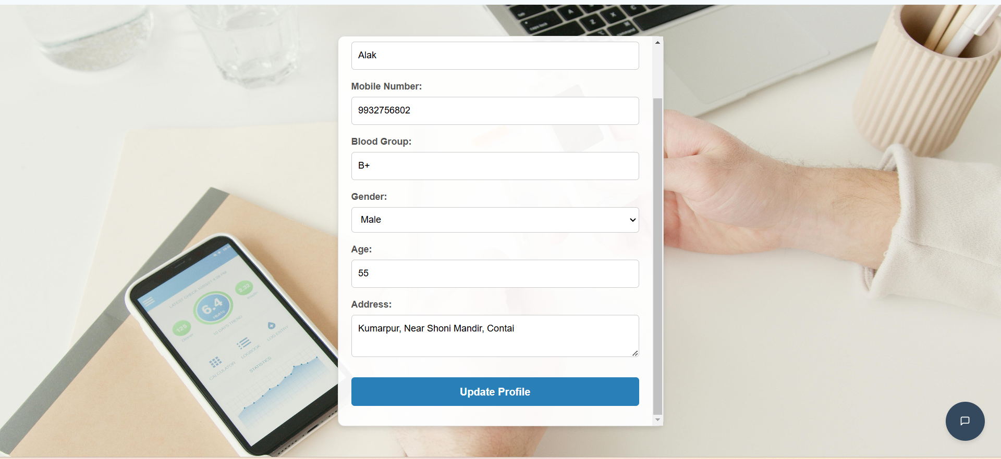
Patient Profile

Slide 20
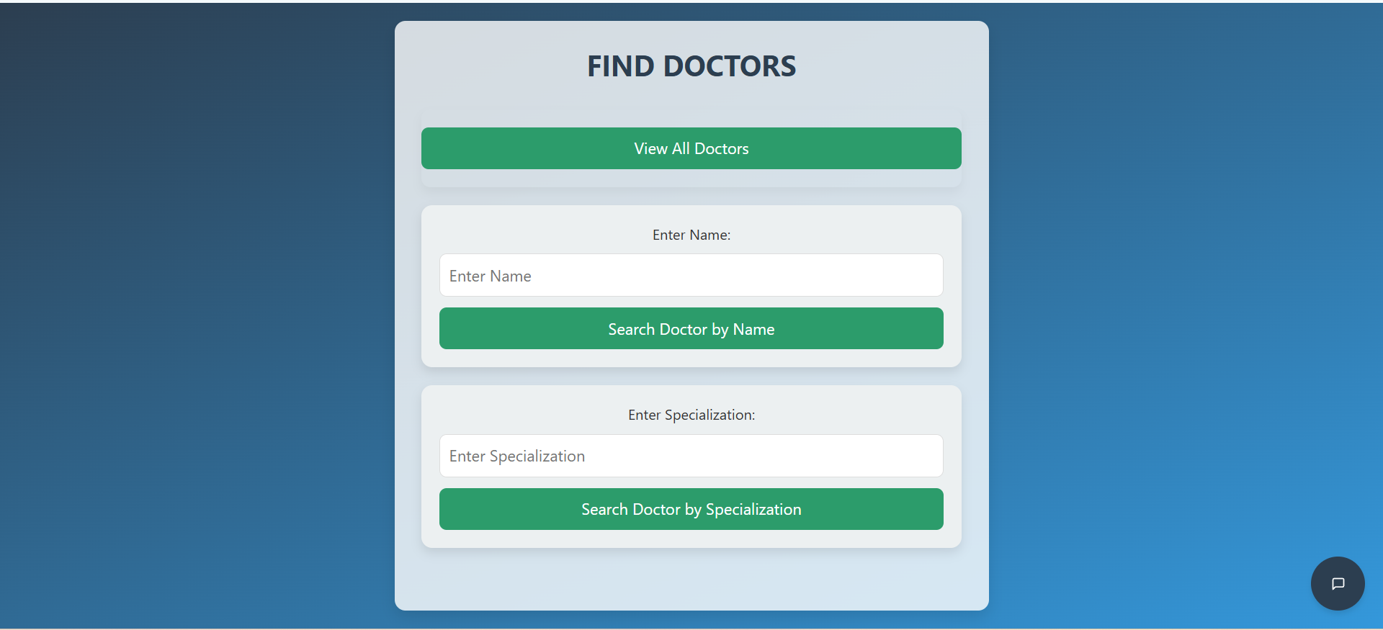
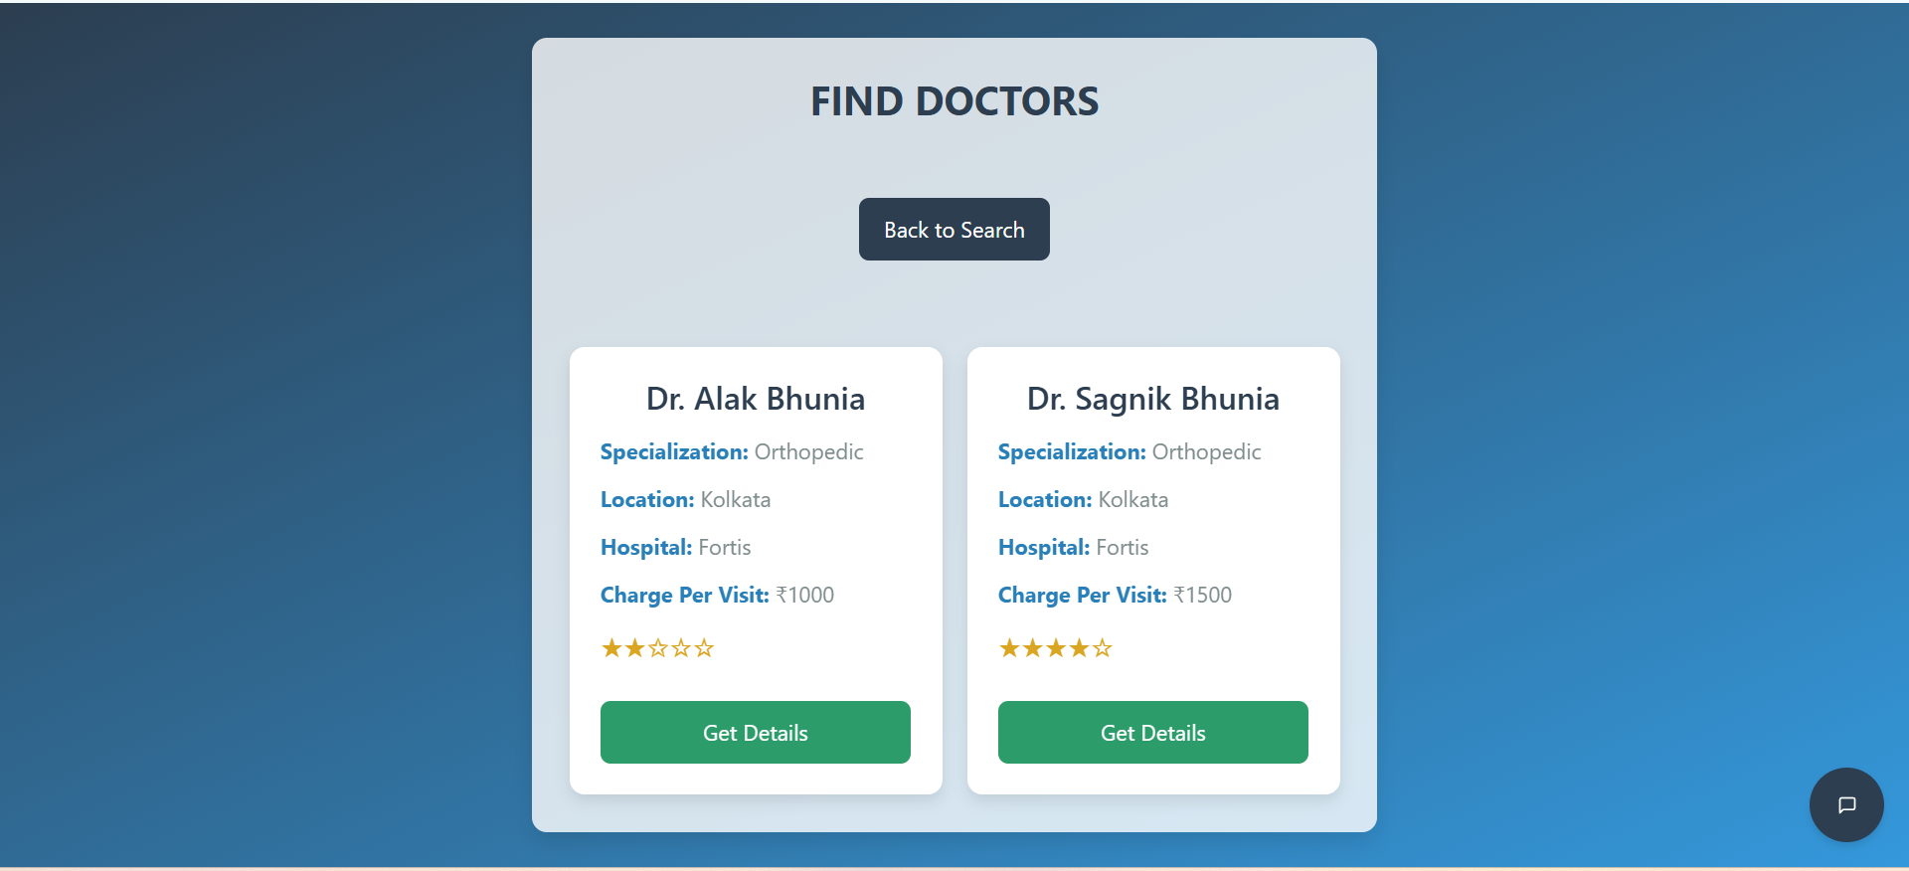
Find Doctors

Slide 21
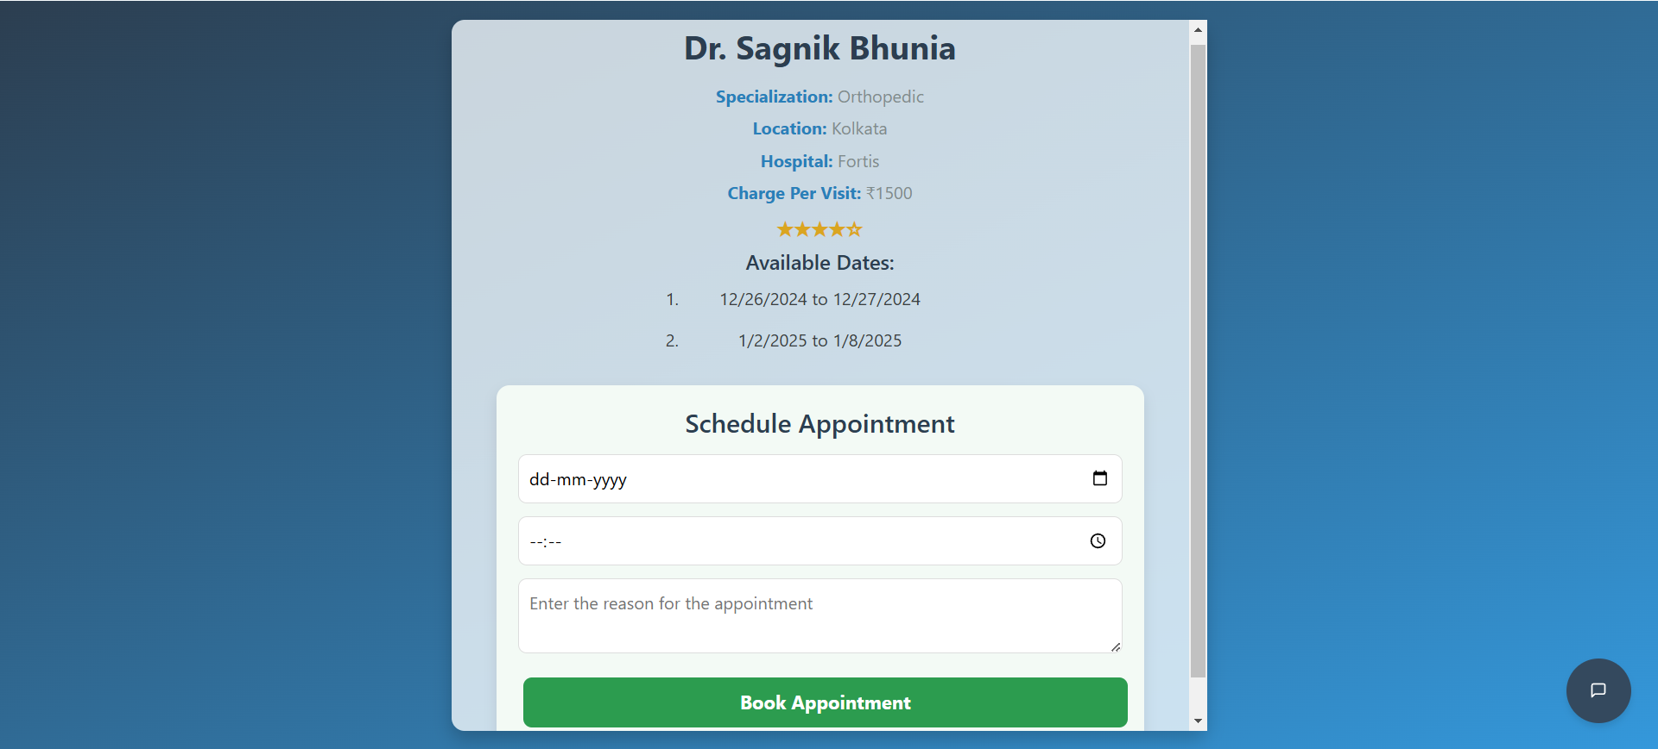
Book Appointment

Slide 22
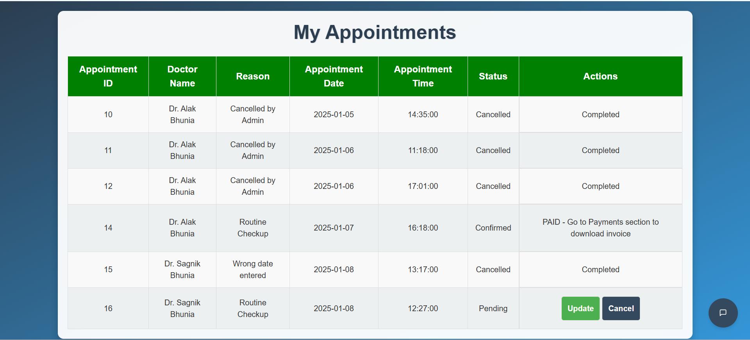
View Appointments

Slide 23
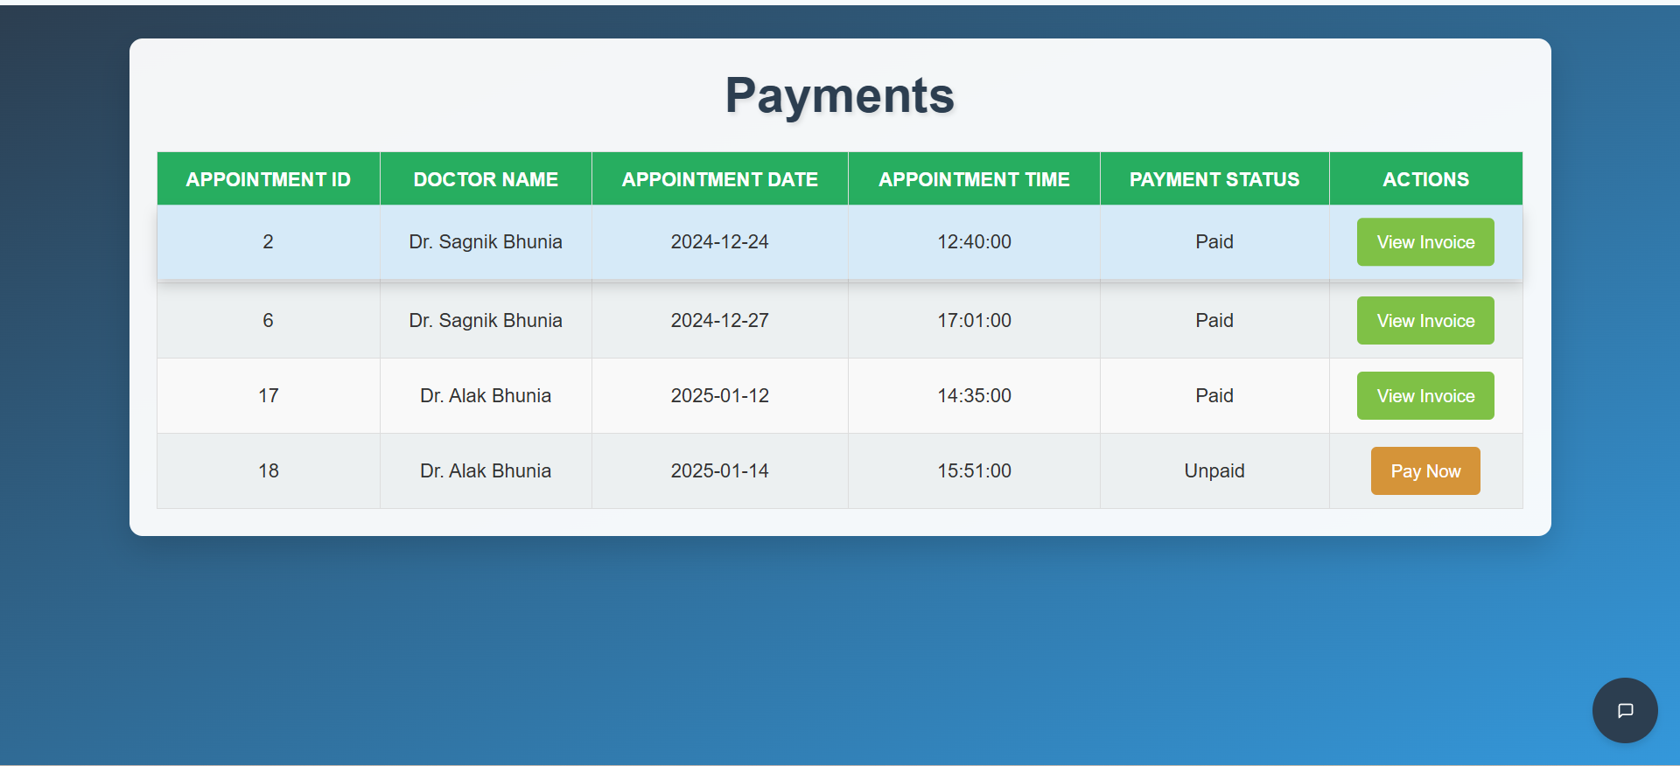
Payments Section

Slide 24
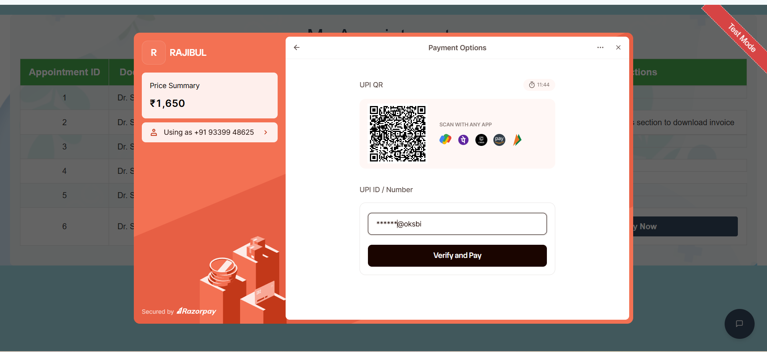
Make Payment

Slide 25
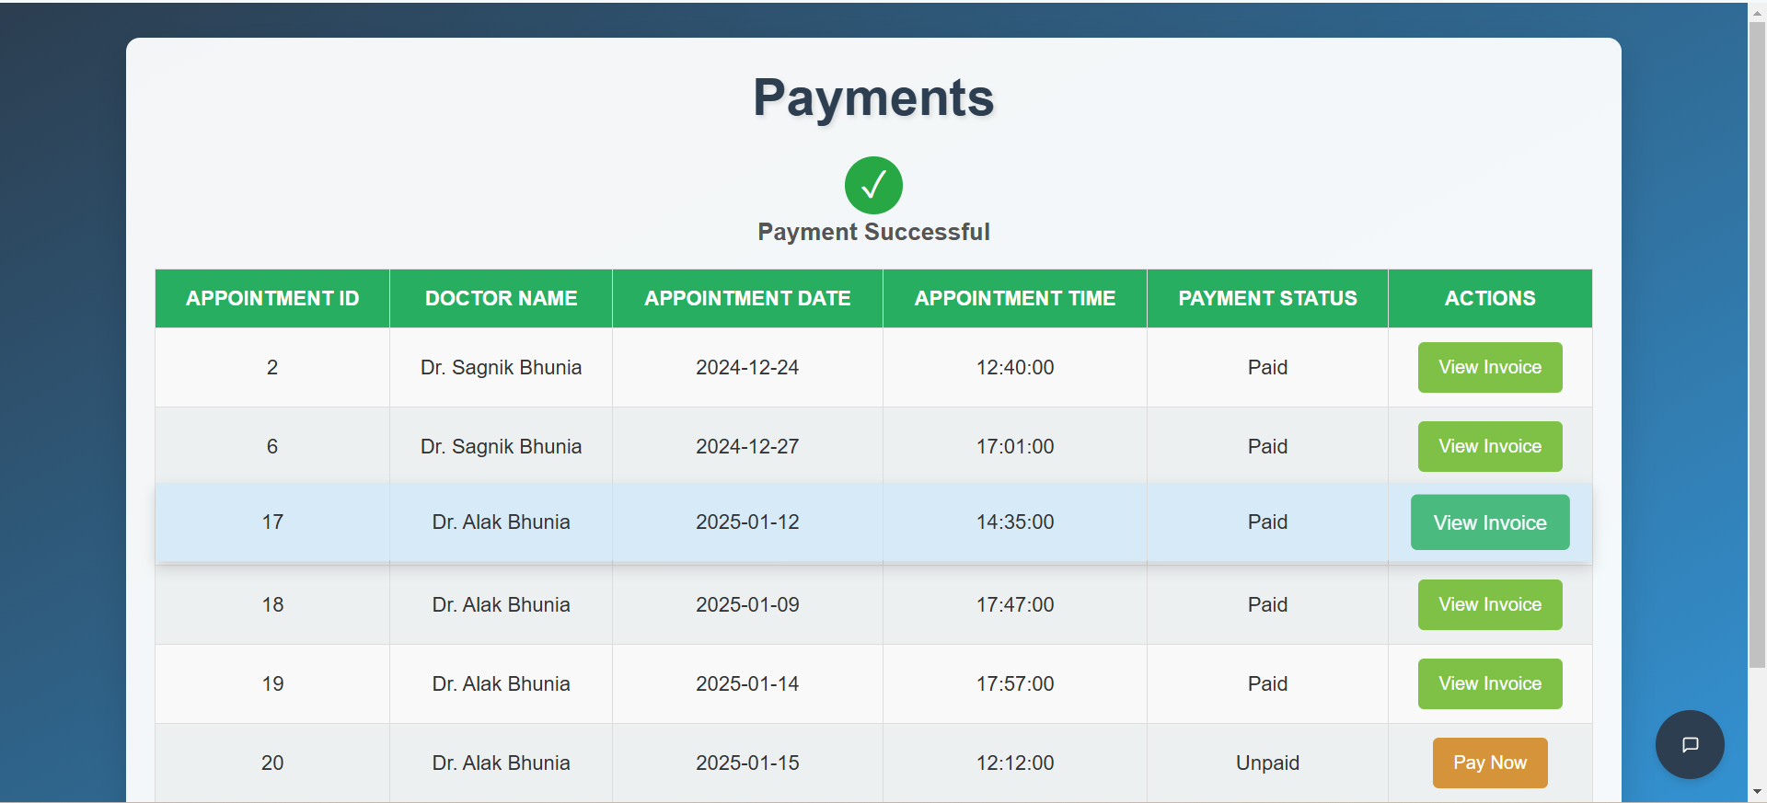
Payment Success Page

Slide 26
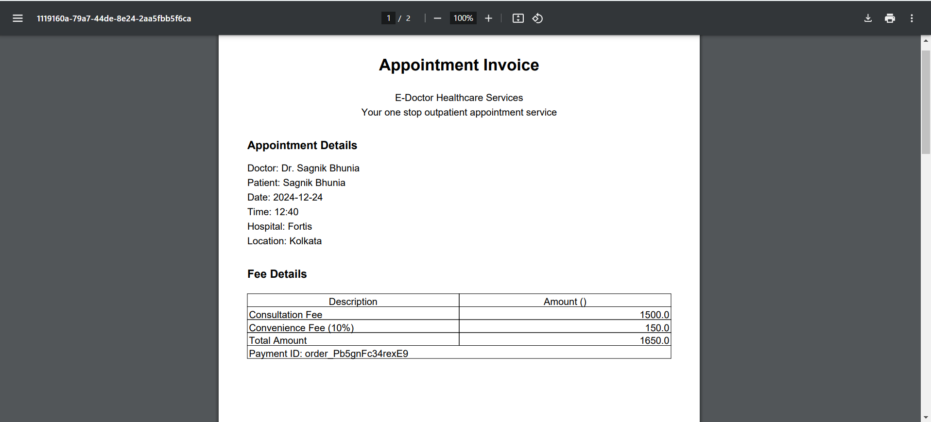
Invoice

Slide 27
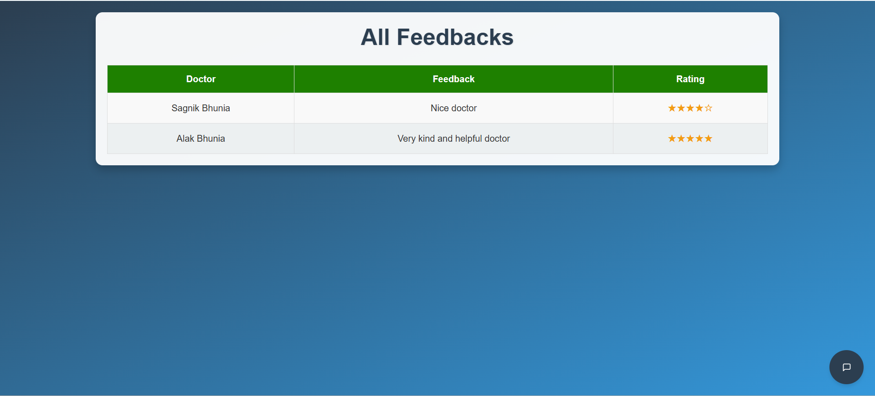
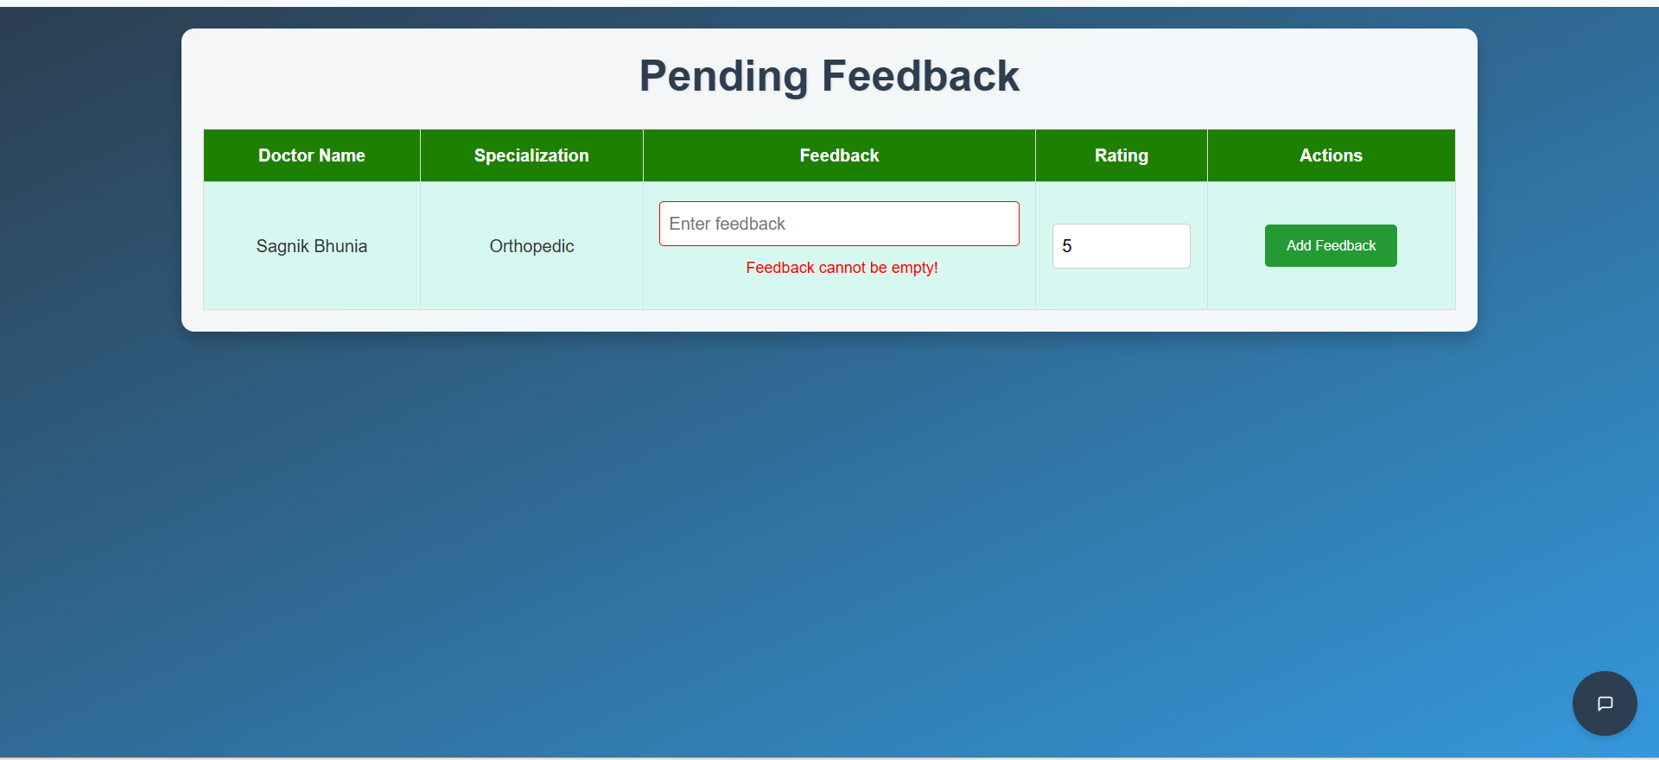
Feedback

Slide 28
03
Doctor
Doctor Profile:
View and update personal information, qualifications, and upload a profile picture.
Manage Availability:
Set working hours, specify time slots, and mark unavailable dates.
Manage Appointments:
View, accept, reject, reschedule, or cancel patient appointments.
View Feedback:
Access patient ratings and feedback after consultations.
Appointment Notifications:
Receive real-time updates for appointment requests, changes, or cancellations.

Slide 29
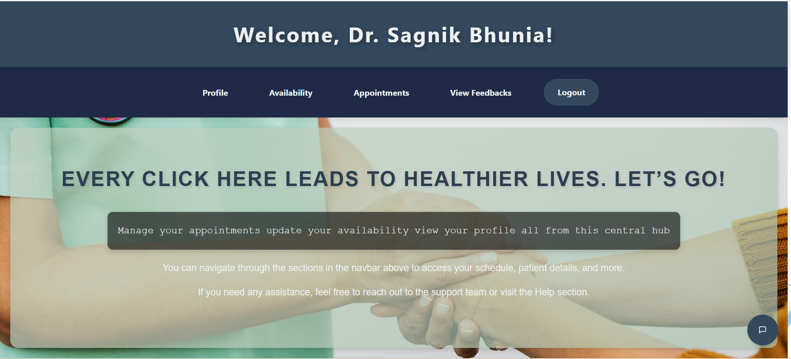
Doctor Dashboard

Slide 30
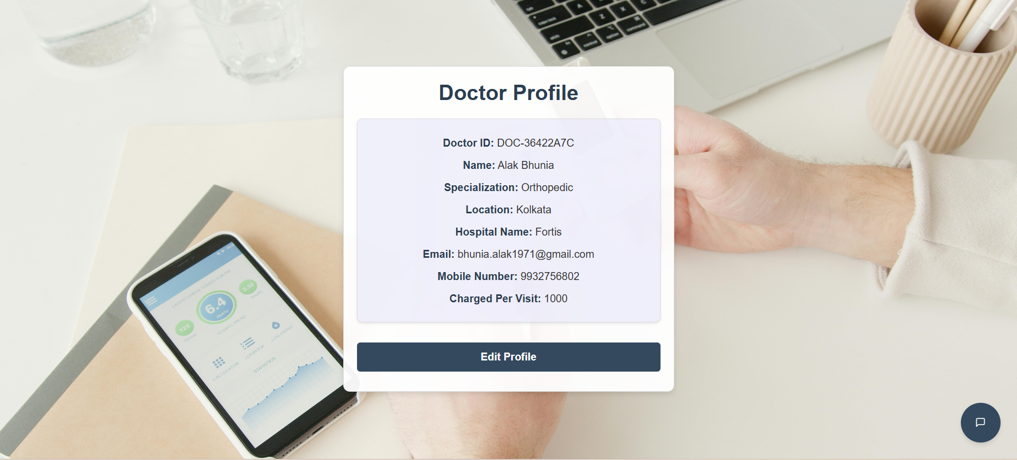
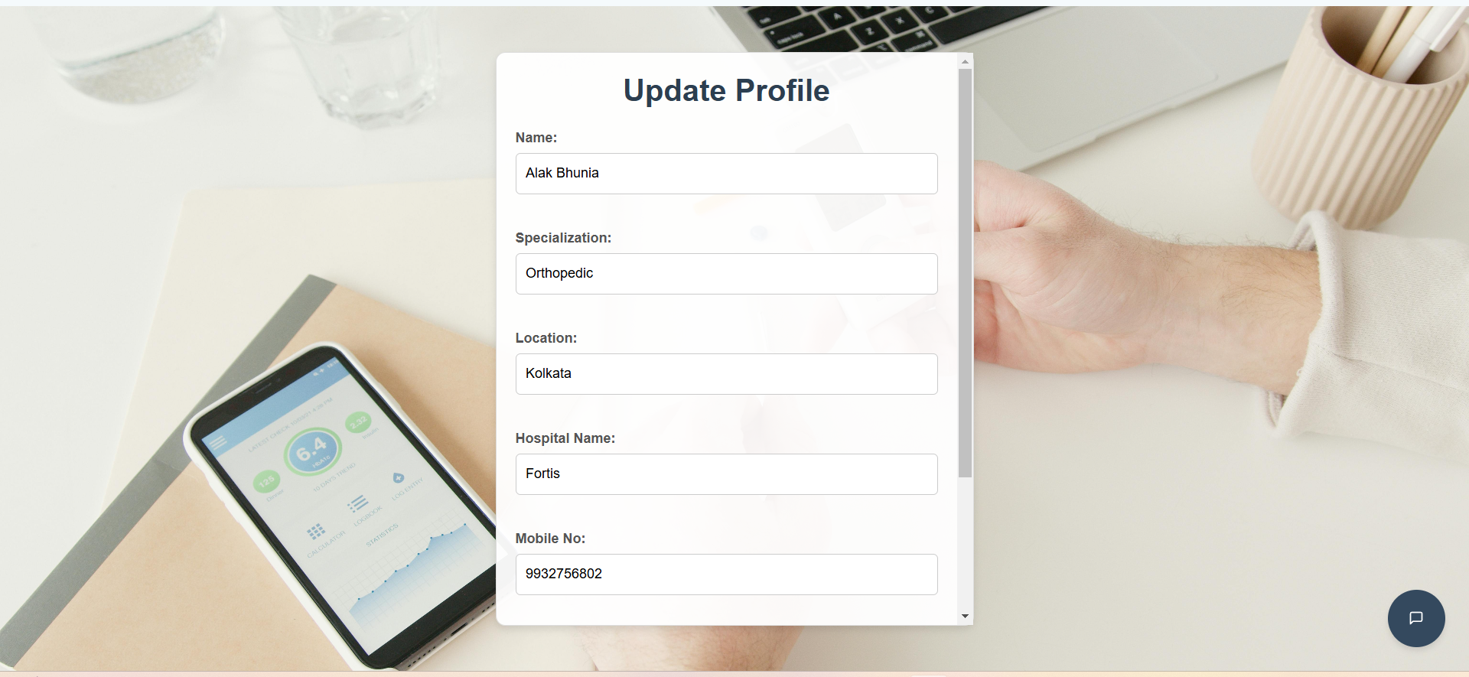
Doctor Dashboard

Slide 31
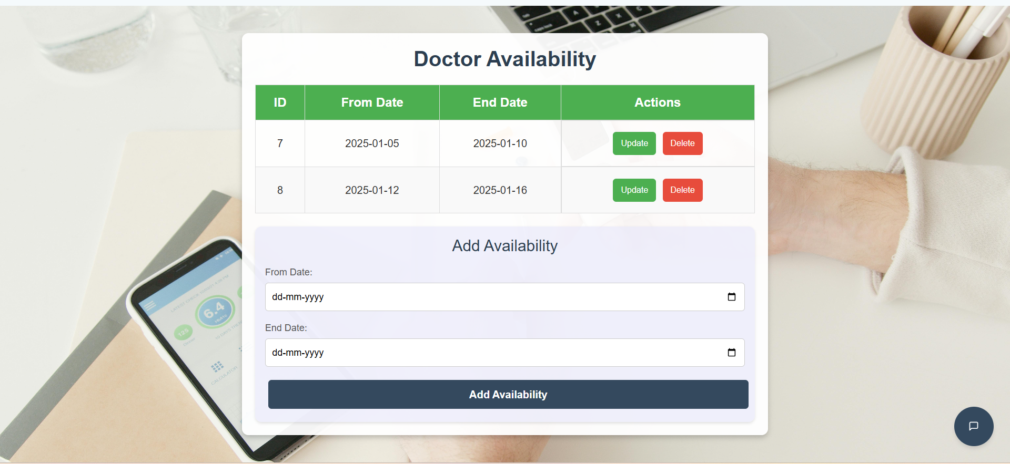
Doctor Availability

Slide 32
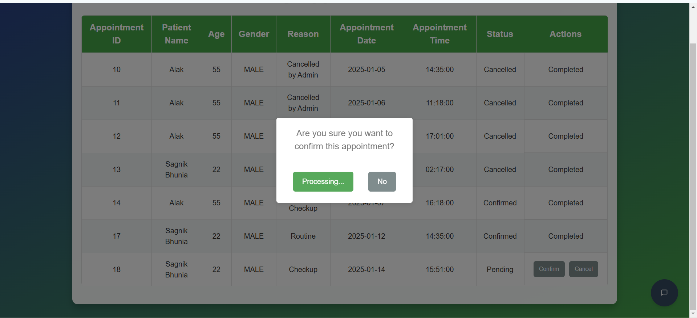
Appointments

Slide 33
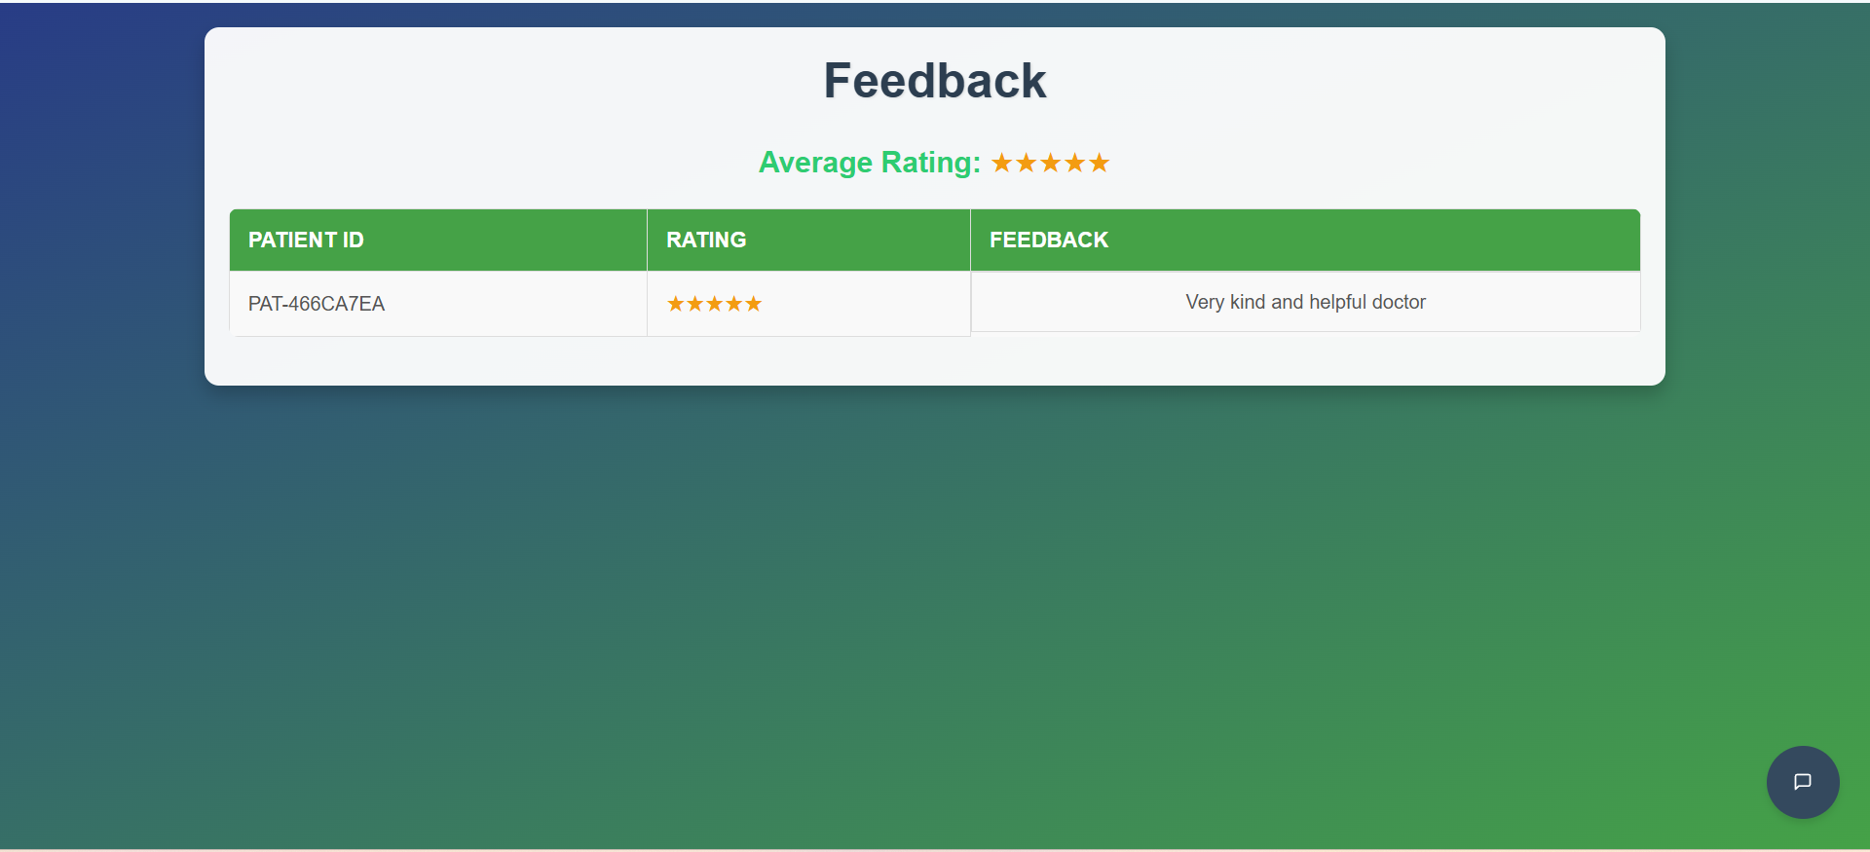
Feedbacks Given by Patients

Slide 34
04
Admin
Manage Patients:
View, add, edit, or delete patient records and manage their medical information.
Manage Doctors:
Add, edit, or remove doctors, and update doctor availability.
Manage Appointments:
View and manage appointments, including scheduling, rescheduling, or cancellations.
Check Statistics:
View daily, weekly, and monthly hospital reports on patient admissions and discharges with graphical charts.

Slide 35
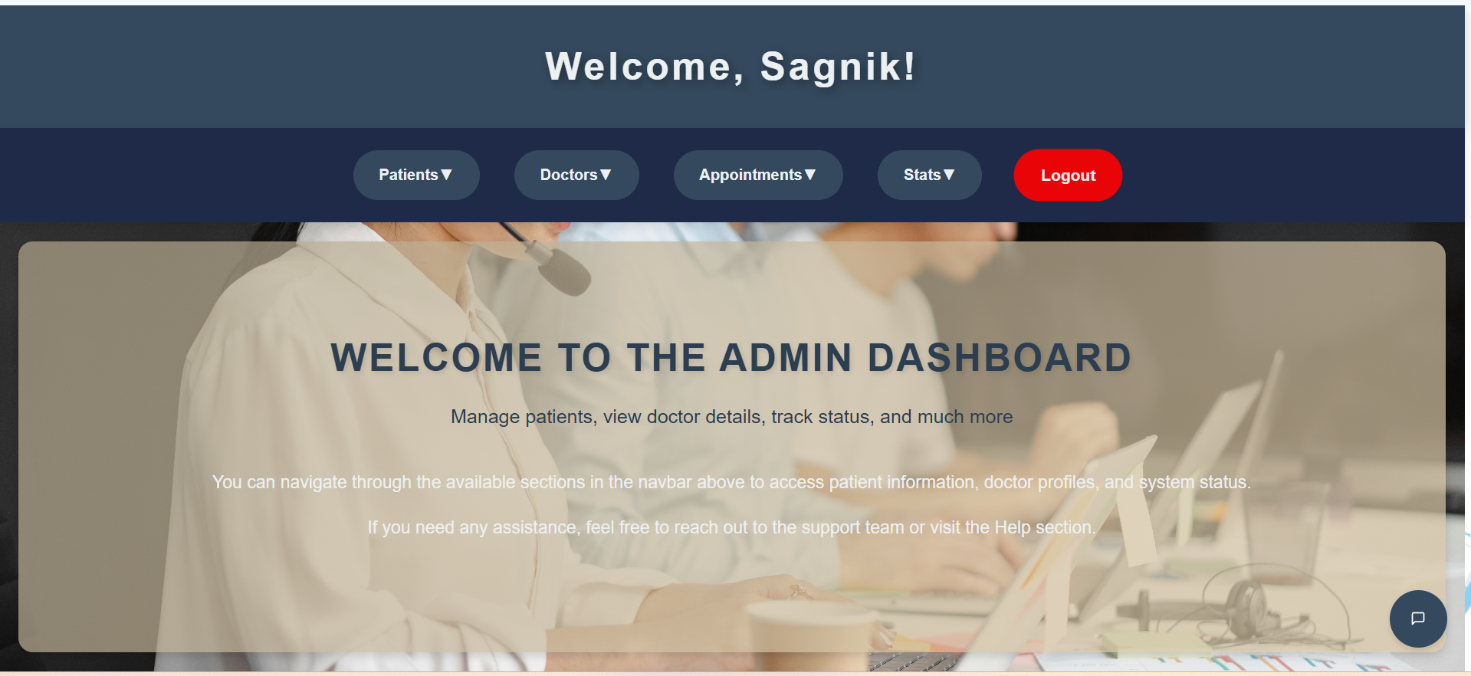
Admin Dashboard

Slide 36
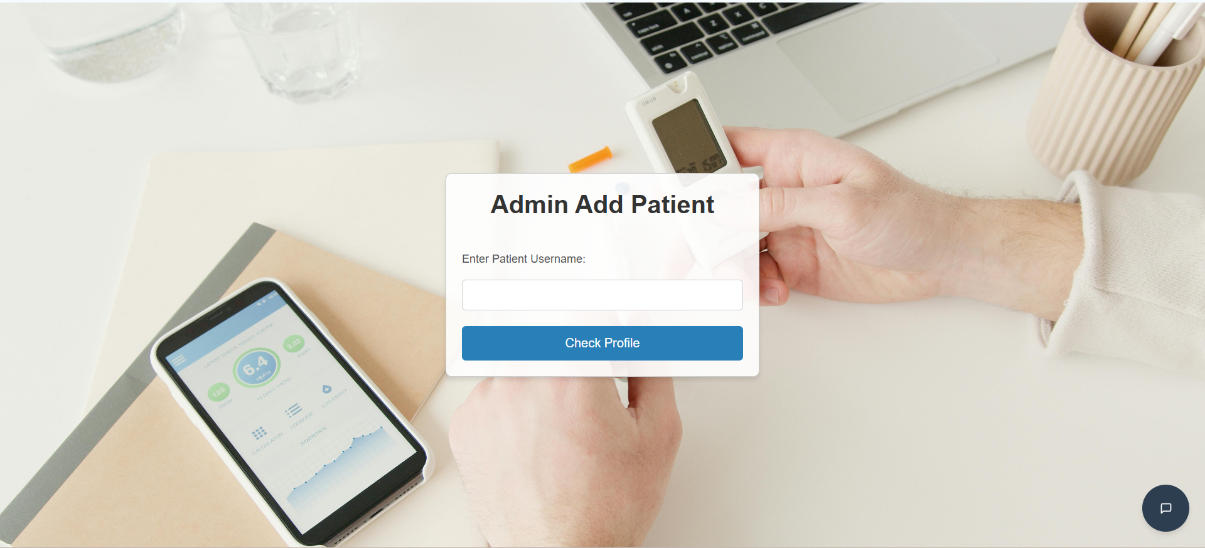
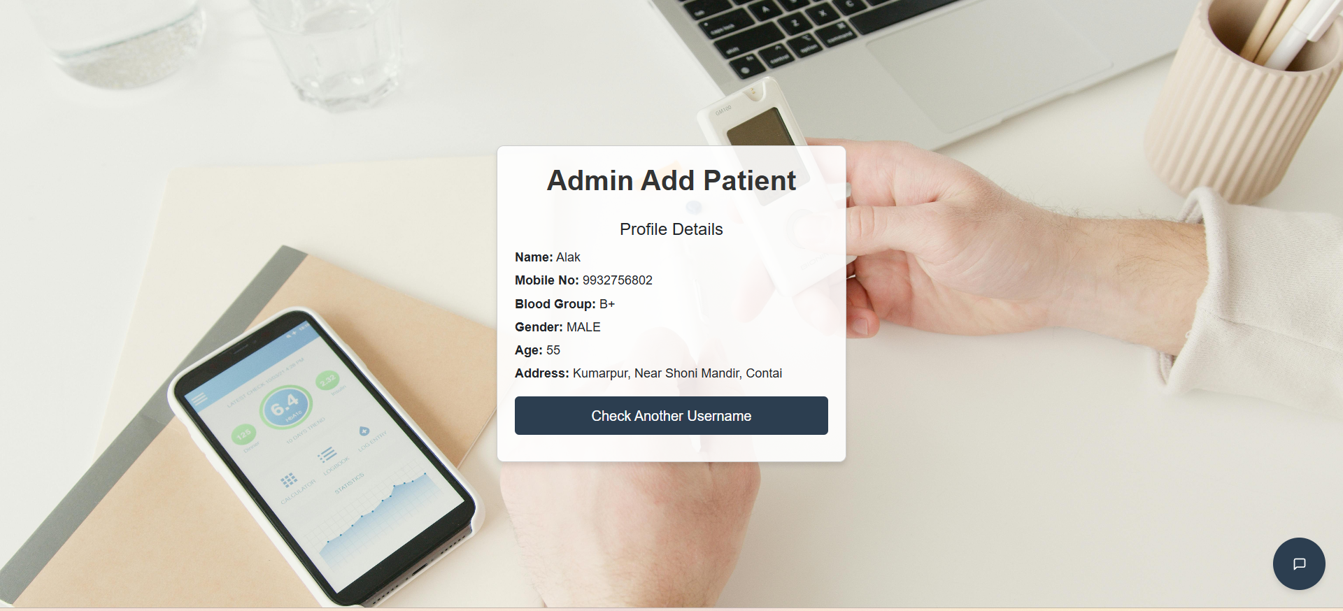
Admin Add Patient

Slide 37
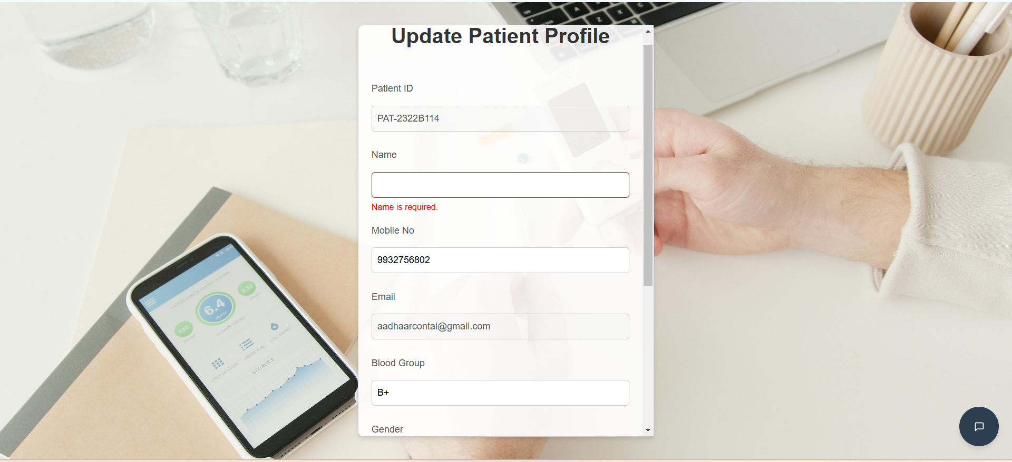
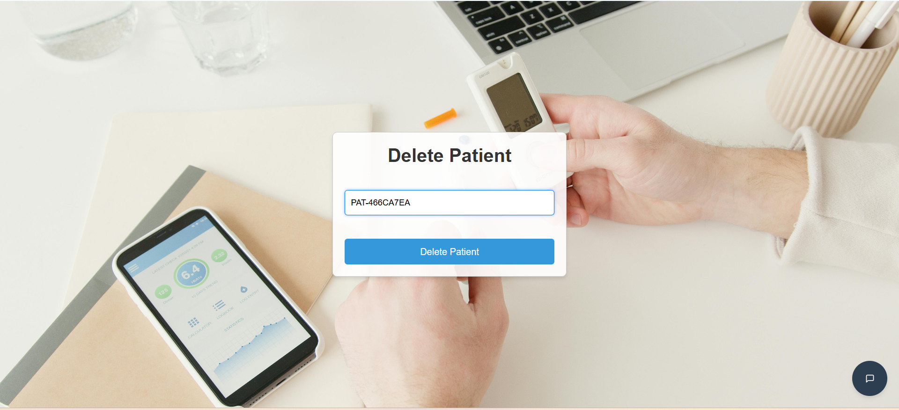
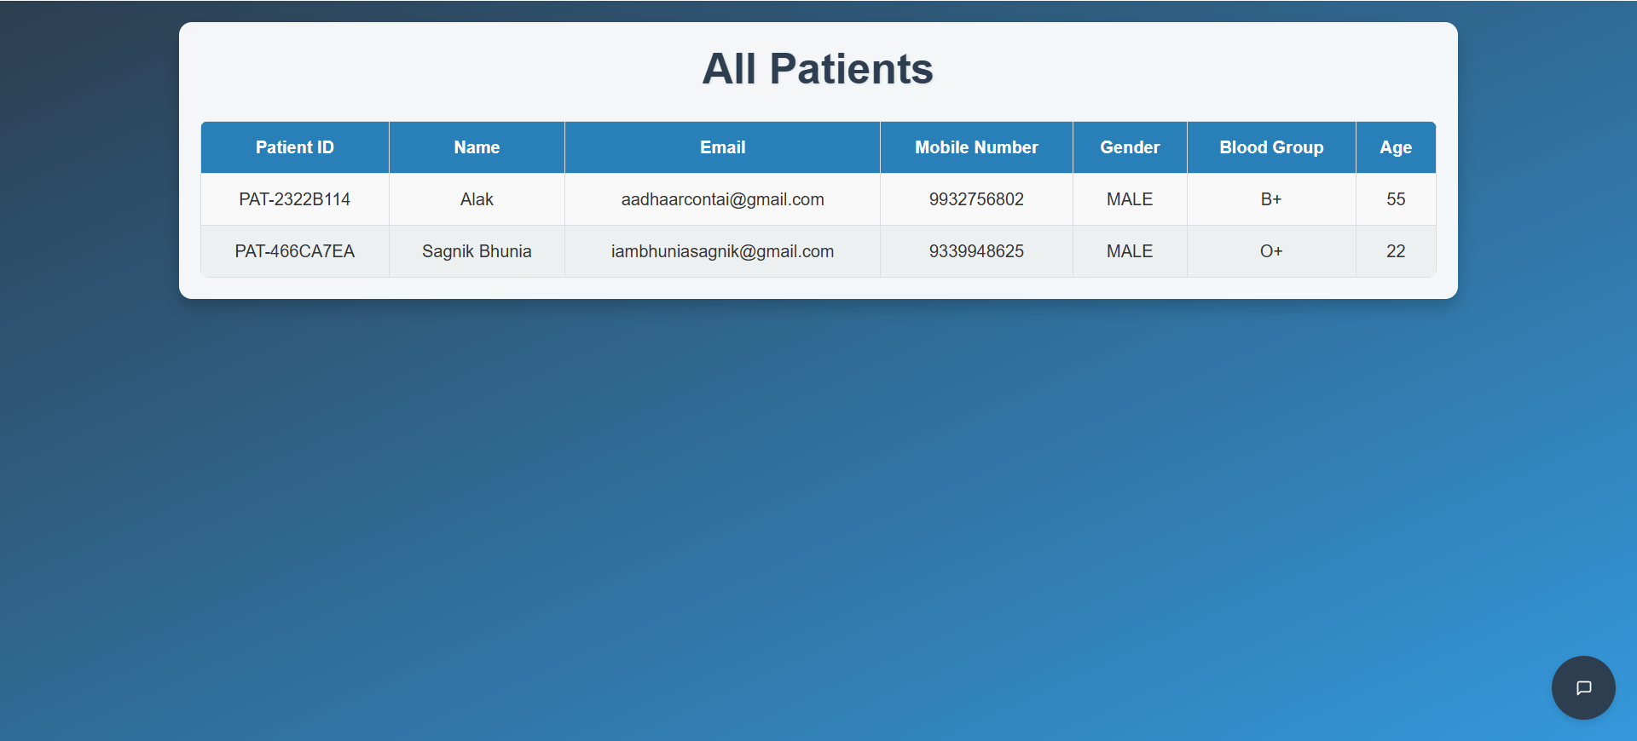
Update, Delete and All Patients Options for Admin

Slide 38
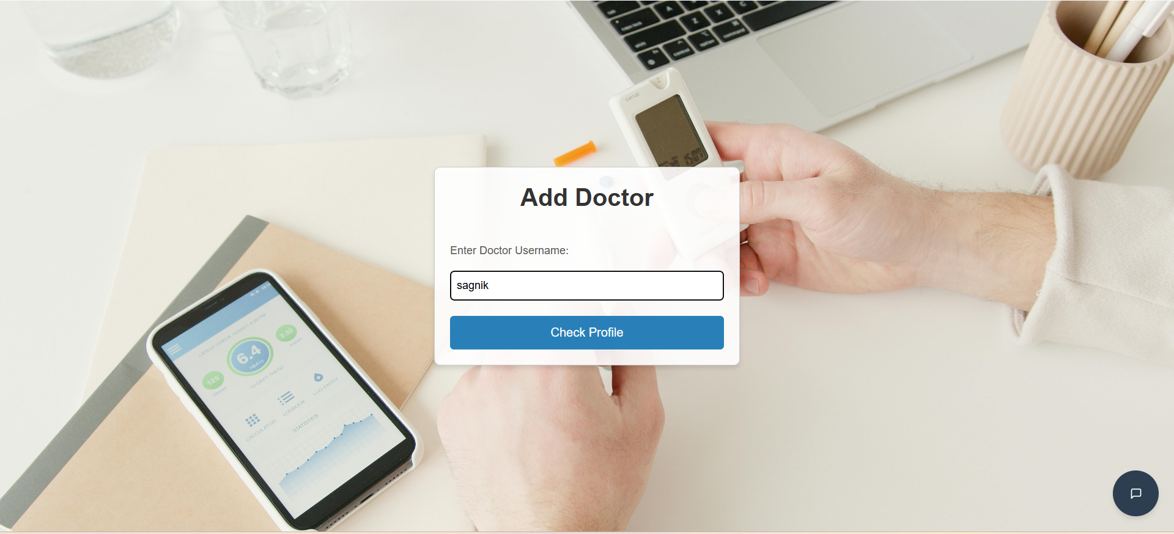
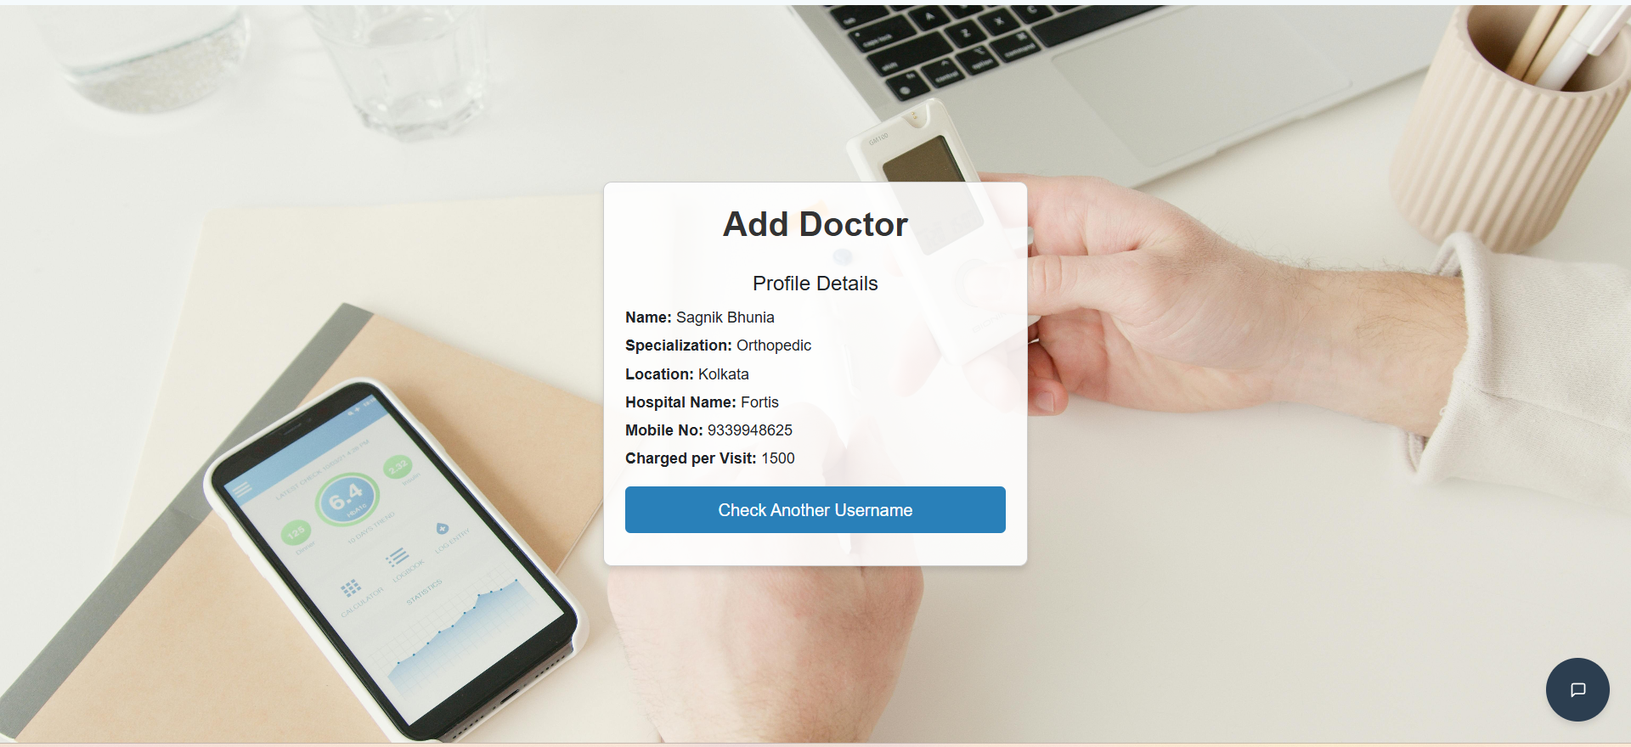
Admin Add Doctor

Slide 39
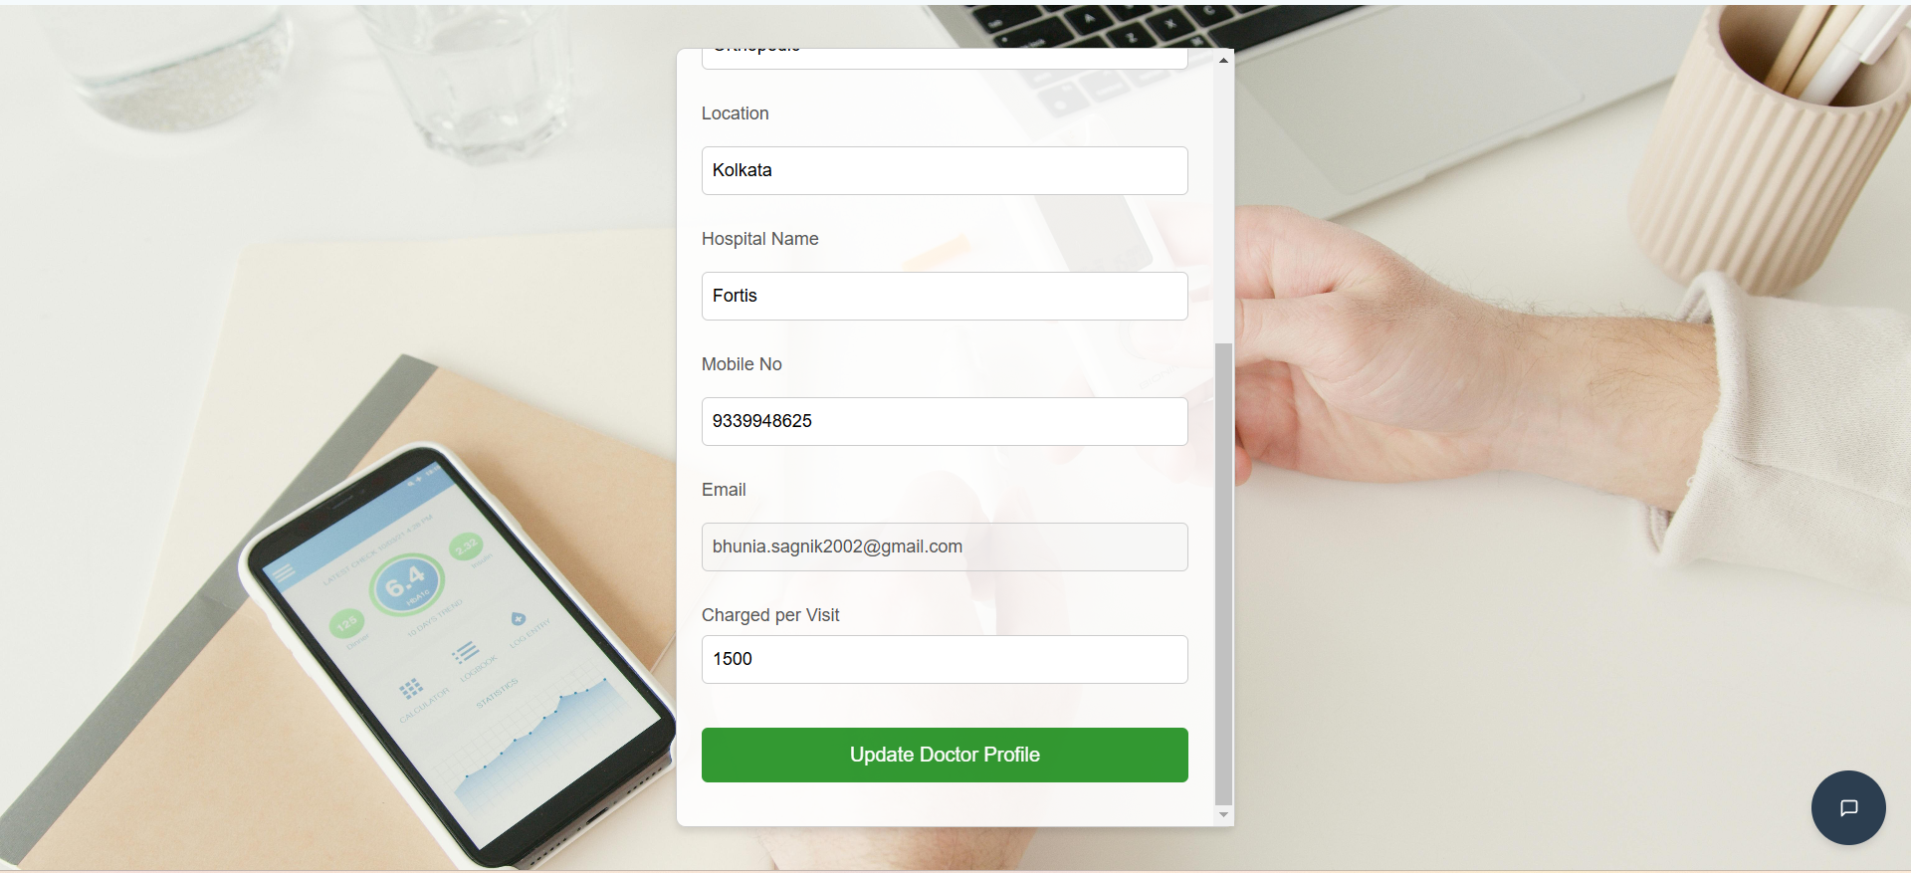
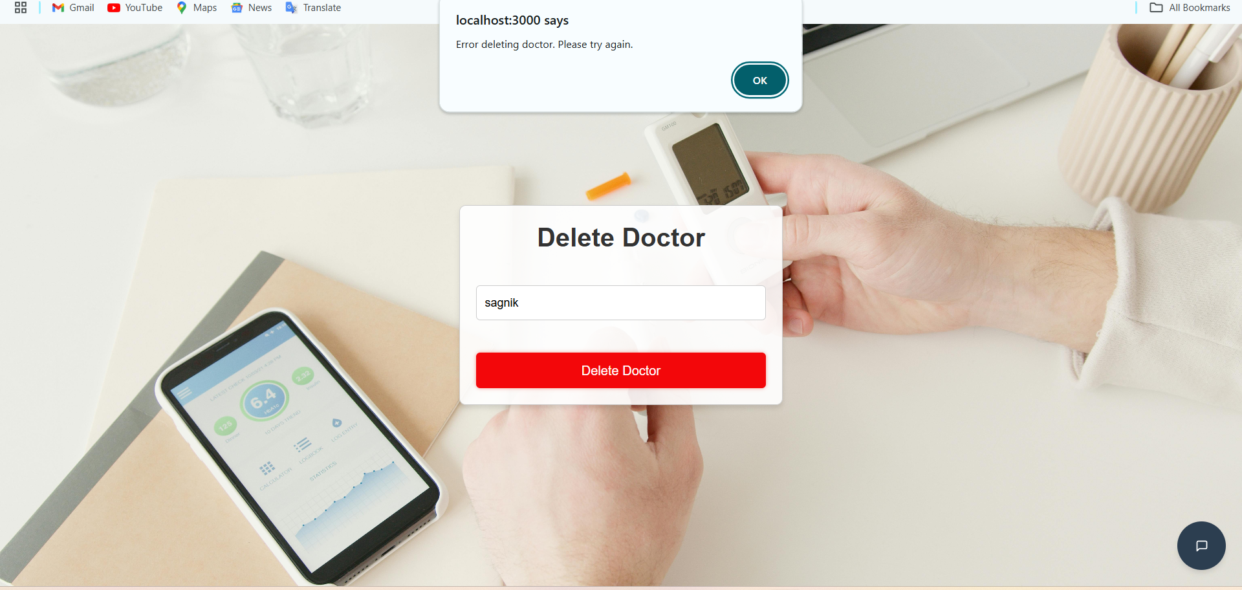
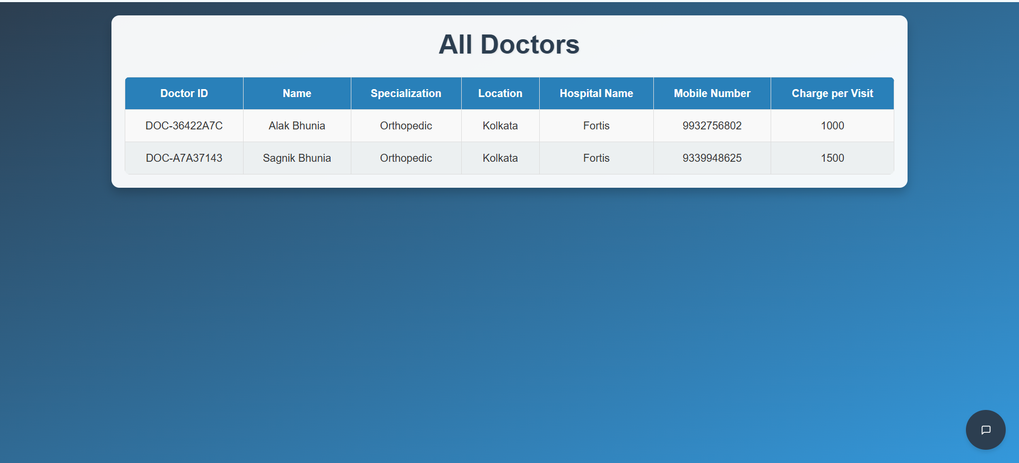
Update, Delete and All Doctors Options for Admin

Slide 40
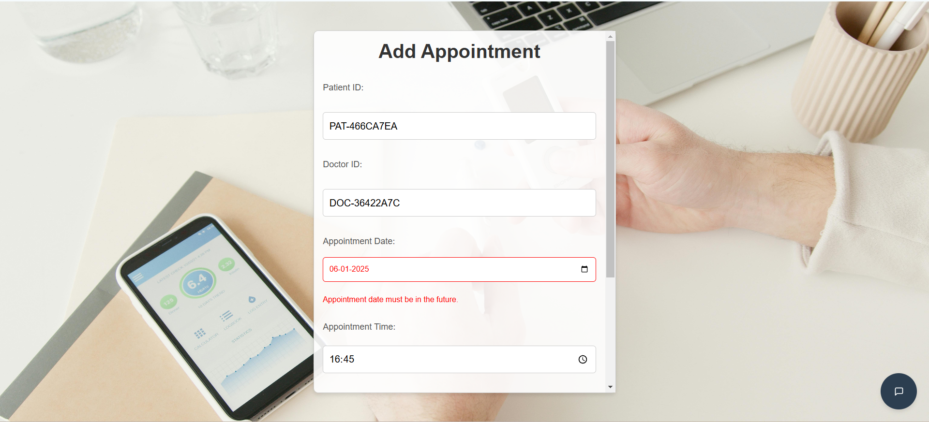
Add Appointment option for Admin

Slide 41
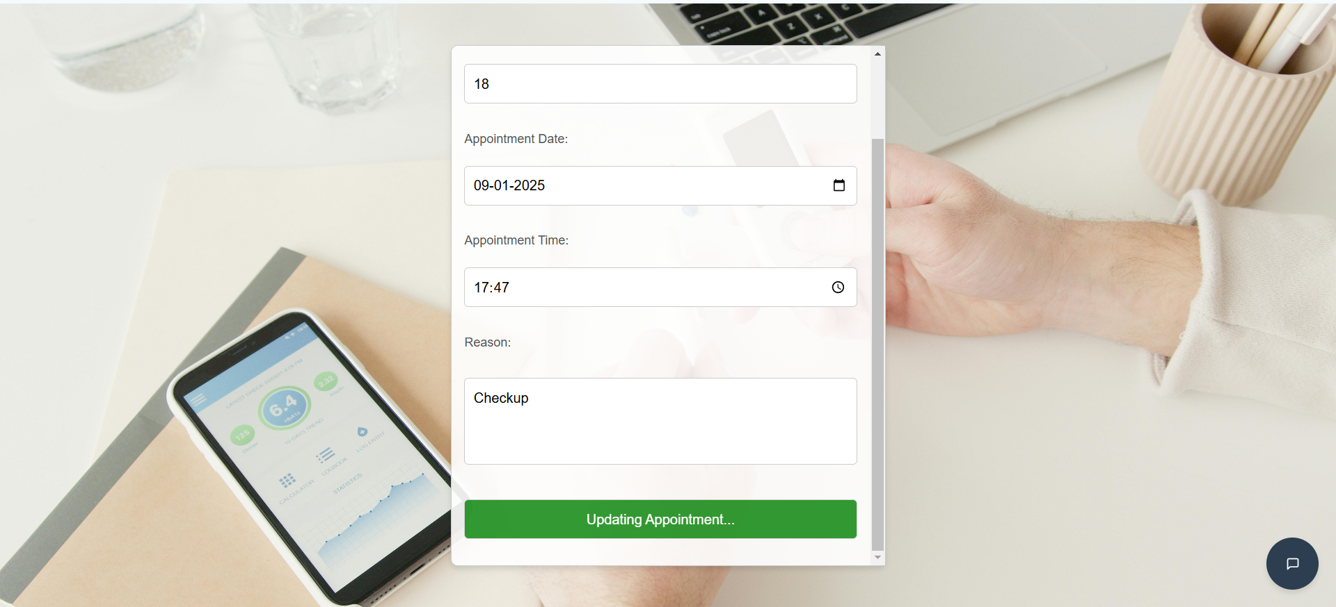
Update Appointment option for Admin

Slide 42
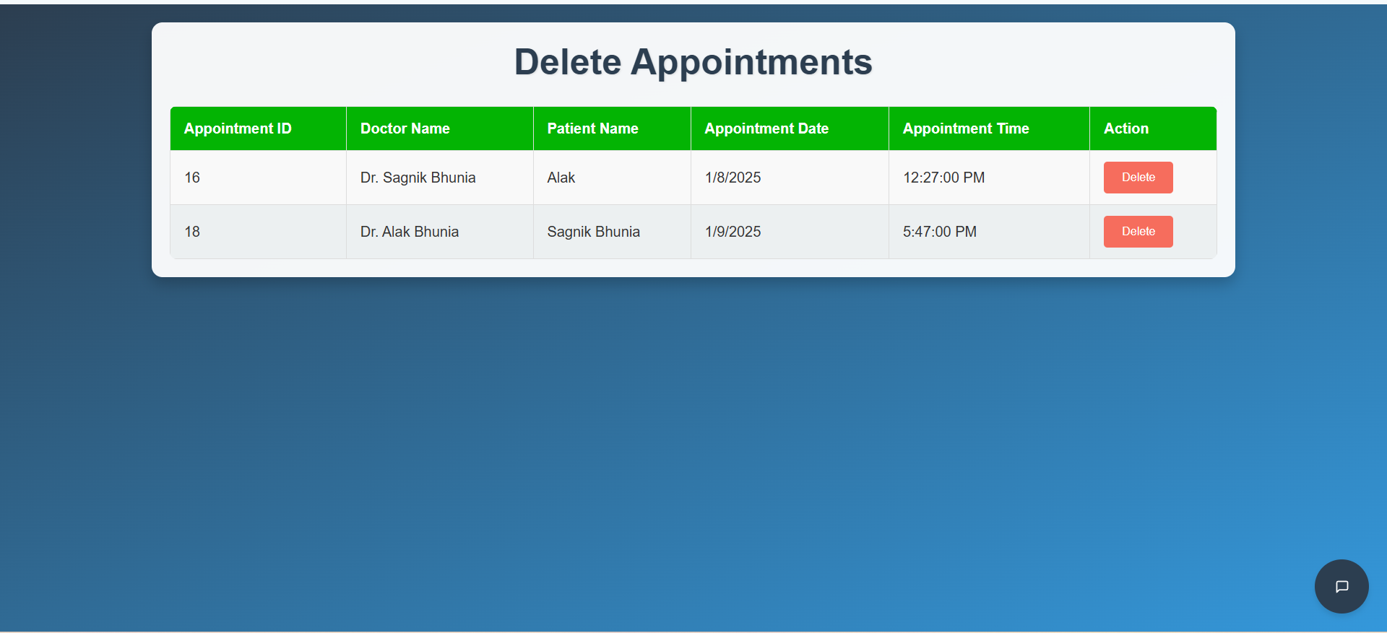
Delete Appointments option for Admin

Slide 43
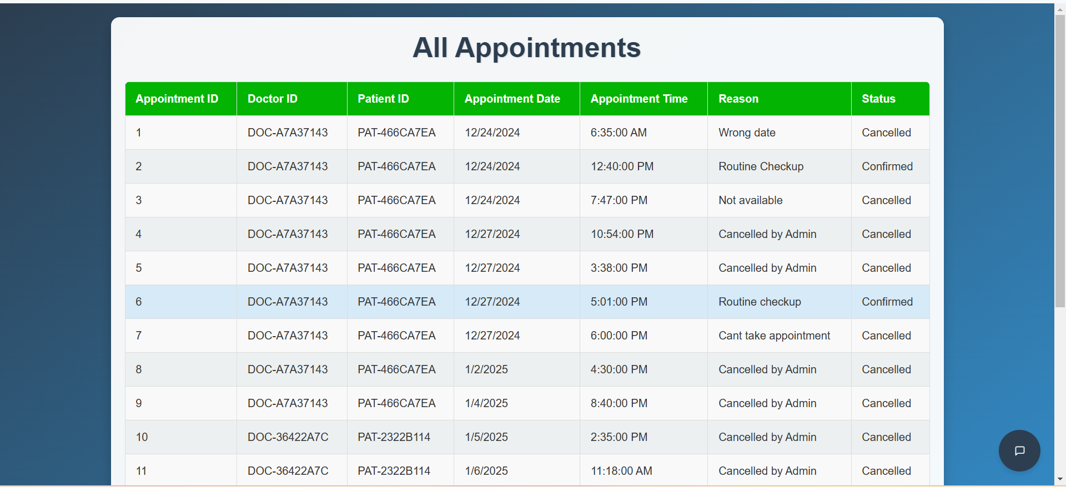
All Appointments option for Admin

Slide 44
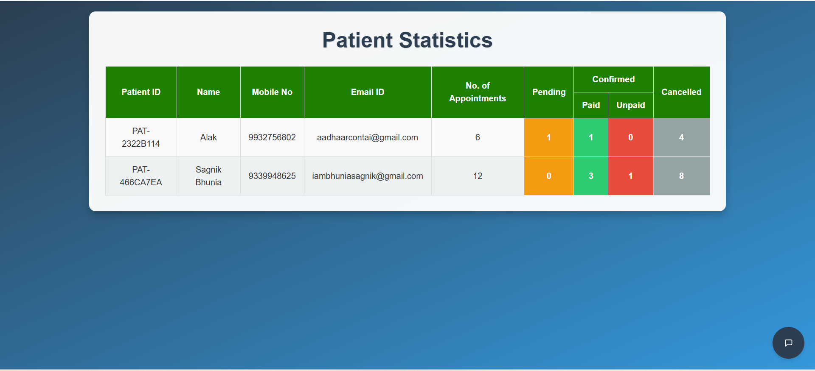
Patient Statistics

Slide 45
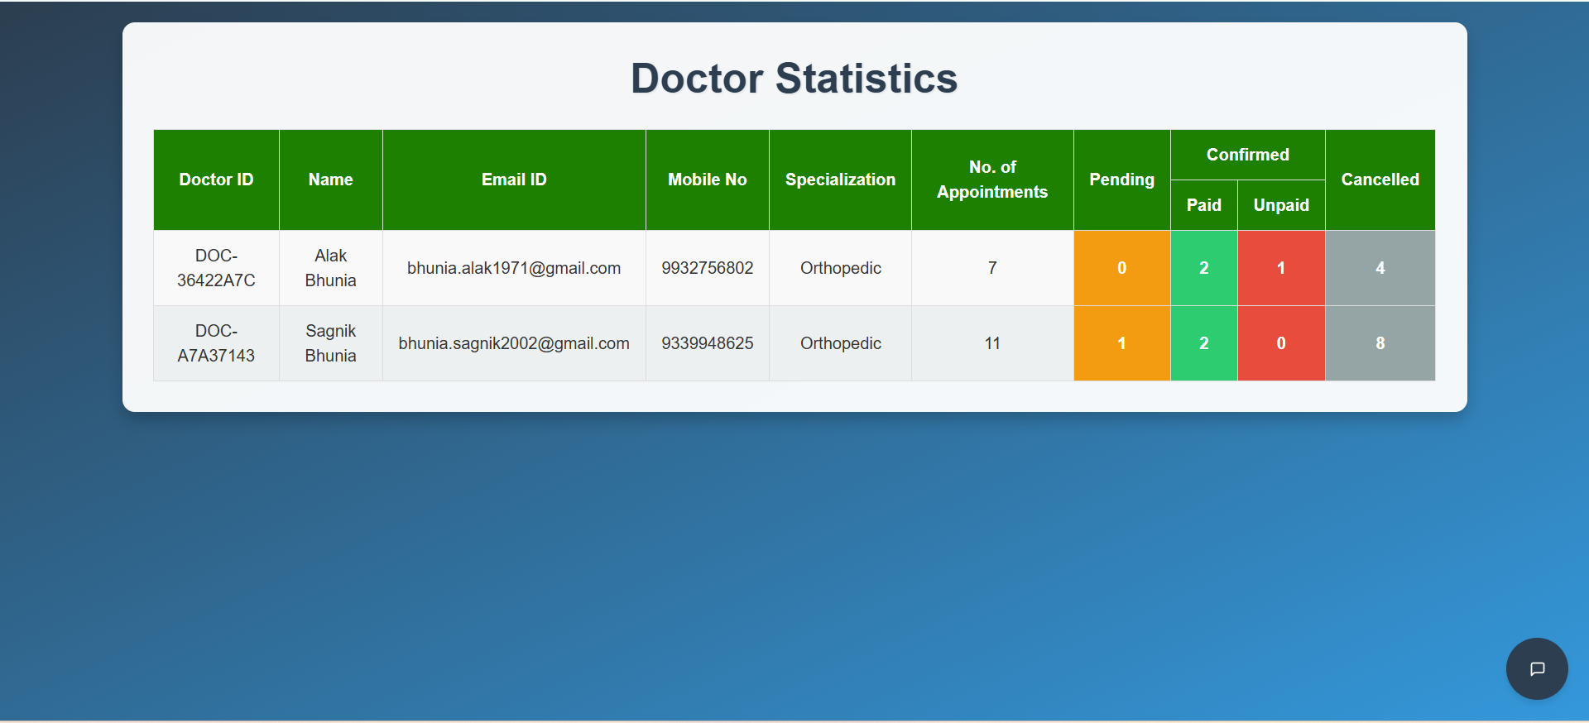
Doctor Statistics

Slide 46
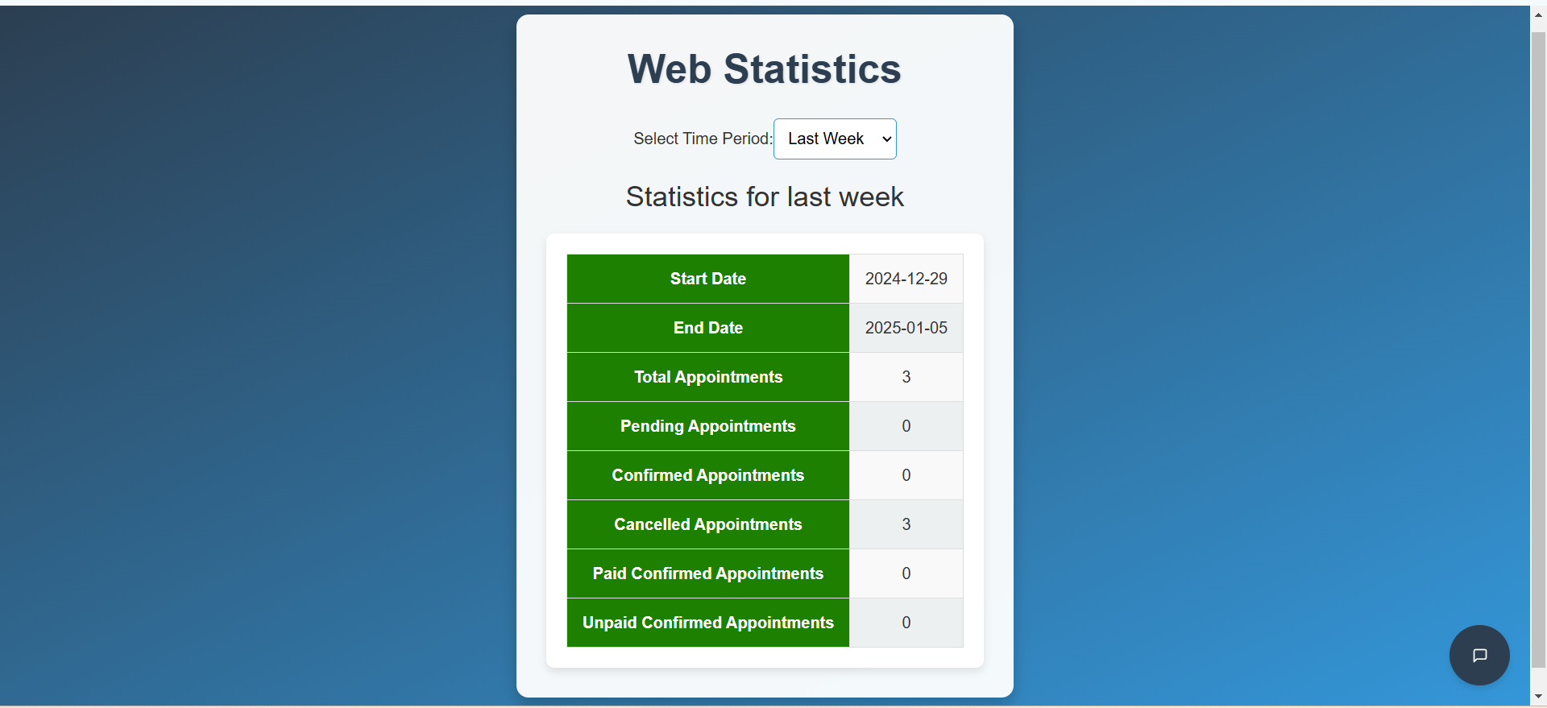
Website Statistics

Slide 47

Acknowledgement
We extend our heartfelt gratitude to our mentors for their invaluable guidance and support throughout the development of the EDoctor Application. Their expertise was crucial in overcoming challenges and ensuring the project's success.
We also thank Infosys Springboard for providing the opportunity to explore new technologies, refine our skills, and apply our knowledge in a practical setting. This experience has been enriching, helping us grow both personally and professionally.

Slide 48
Conclusion
The EDoctor Application demonstrates our ability to design and implement a comprehensive solution for streamlining outpatient appointment management. By integrating modern technologies like React, Spring Boot, and MySQL, we created a user-friendly platform catering to patients, doctors, and administrators.
This project not only enhanced our technical skills but also fostered teamwork, problem-solving, and innovation. We believe the application holds immense potential to improve efficiency in healthcare systems and deliver a seamless experience for all users.

Slide 49
THANK YOU
Stay healthy and have a nice day

